Slide 1

Zürich vLLM Meetup
Welcome to the first official vLLM Meetup in Europe!
6 November 2025

Slide 2
Agenda
Time | Title Title | Speaker
​5:30 PM | Welcome & Opening Remarks
​5:40 PM | Intro to vLLM and Project Update | Michael Goin, Lead vLLM Maintainer & Principal Engineer, Red Hat AI
6:00 PM | From Beginner to Advanced Quantization in vLLM | ​Eldar Kurtić, Principal Research Scientist, Red Hat AI Dan Alistarh, Professor at ISTA & Researcher, Red Hat AI
​6:30 PM | Training Mistral Reasoning Models using vLLM | Patrick von Platen, Research Engineer, Mistral AI Julien Denize, Open Source Engineer, Mistral AI
6:45 PM | P/D Disaggregated Serving in Production with vLLM | Mickaël Seznec, GPU Engineer, Mistral AI Mathis Felardos, Inference/Software Engineer, Mistral AI
​7:00 PM | Hybrid Models as First-Class Citizens in vLLM | Thomas Parnell, vLLM Committer & Principal Research Scientist, IBM
​7:20 PM | Distributed Inference with vLLM and llm-d | ​Tyler Michael Smith, Lead vLLM Maintainer & Chief Architect - Inference Engineering, Red Hat AI
​7:50 PM | 🍕🥗🍷 Q&A, Food, Drinks, and Networking 🍻 🍰

Slide 3
Opening Remarks
Michael Goin
Lead vLLM Maintainer & Principal Engineer, Red Hat AI

Slide 4

Vision
Mission
At Red Hat we believe the future of AI is Open – source, models, infrastructure, serving.
We are on a mission to bring the power of open-source LLMs and vLLM to every enterprise on the planet.

Slide 5





The world changed in November 2022
ChatGPT woke the world up to the power of generative AI

Slide 6












The power of open
There has been an explosion of capability in open models over the last 2 years
No OSS
models
RedPajama, MPT, Falcon
Mistral,
Granite 2
Mixtral,
Phi-2
Llama 3,
Qwen2
DBRX, Granite 3
Qwen2-VL
DeepSeek-R1
Jan
2023
Mar
2023
May
2023
July 2023
Sept
2023
Nov 2023
Jan
2024
Mar
2024
May
2024
July
2024
Sept 2024
Nov 2024
Jan 2025
Aug 2025
Llama
Llama 2
Zephyr
DBRX, Phi-3
Gemma2, Nemotron
Phi-3, Arctic
gpt-oss

Slide 7
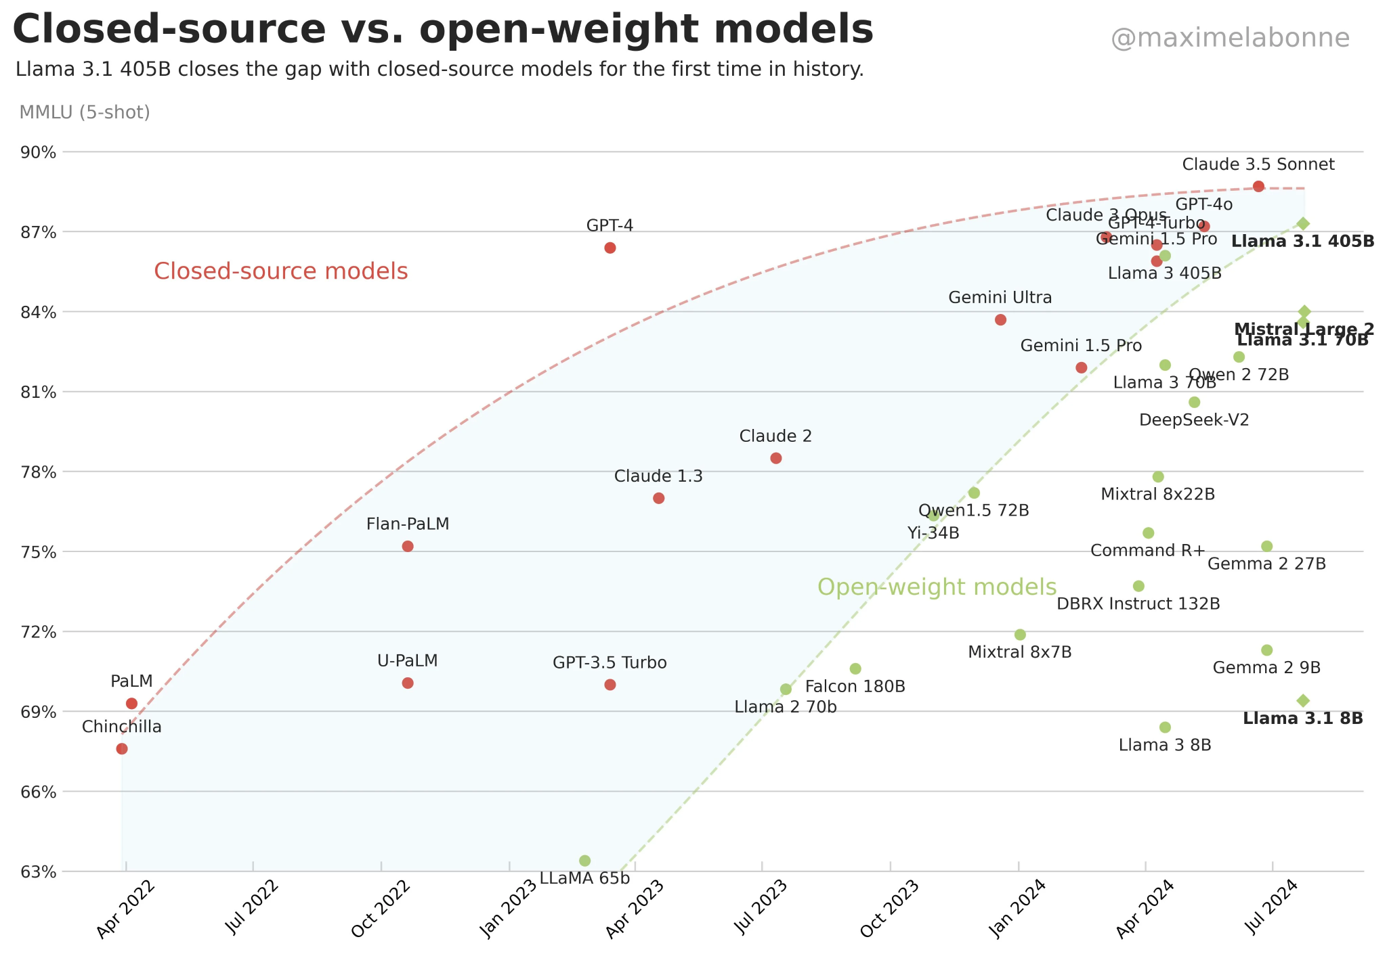
The power of open
Open models are deployment targets today – and the trend is not slowing down
Headlines
650M downloads in 2024
85,000 Llama derivative models
1B, 3B, 8B, 70B, 405B variants
Multilingual, Multimodal, Mobile
Llama
First reasoning model on par in quality with OpenAI o1
1-70B parameter distilled versions
Global market pandemonium?
R1
Models are commoditizing → many options for diverse enterprise needs

Slide 8
Advantages of open weight models and serving stack
Open models play an important role in the enterprise AI landscape
Cost
Self managed infrastructure
1B-1000B size - match task difficulty to model
Customization
Improve accuracy and costs with task specific tuning
Control
Model lifecycle (no changes to the model in place)
Resources (no rate limits / API downtime)
Security
Complete data privacy (no 3rd party APIs)

Slide 9

















vLLM: The De Facto Open GenAI Inference Platform
vLLM has emerged as the Linux of GenAI Inference
Llama
Qwen
DeepSeek
Gemma
Mistral
Molmo
Phi
Nemotron
Granite
GPU
Instinct
TPU
Neuron
Gaudi
Spyre
Physical
Virtual
Private Cloud
Public Cloud
Edge

Slide 10
Why vLLM and how to get started
Michael Goin
Lead vLLM Maintainer & Principal Engineer, Red Hat AI

Slide 11
vLLM’s Goal
Build the fastest and easiest-to-use open-source LLM inference & serving engine

Slide 12

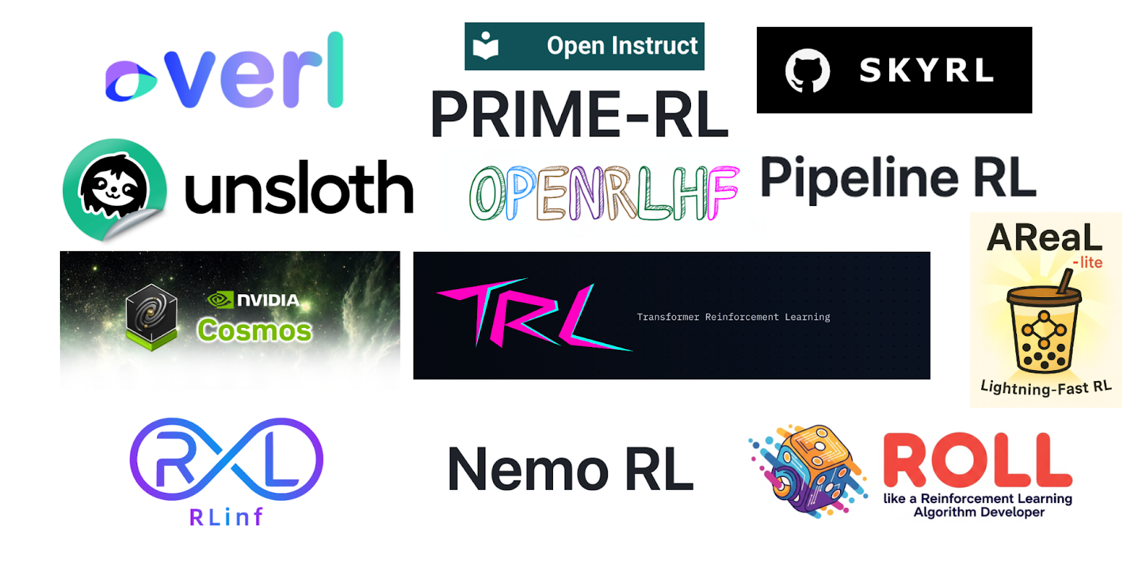





vLLM = ecosystem of model, accelerators and frameworks
$ uv pip install vllm --torch-backend=auto
$ vllm serve deepseek-ai/DeepSeek-V3.1 -tp 8
👋
…
…

Slide 13
vLLM API (1): LLM class
A Python interface for offline batched inference
from vllm import LLM
# Example prompts.
prompts = ["Hello, my name is", "The capital of France is"]
# Create an LLM with HF model name.
llm = LLM(model="openai/gpt-oss-20b")
# Generate texts from the prompts.
outputs = llm.generate(prompts) # also llm.chat(messages)]

Slide 14
vLLM API (2): OpenAI-compatible server
A FastAPI-based server for online serving
Server
$ vllm serve openai/gpt-oss-20b
Client
$ curl http://localhost:8000/v1/responses \
-H "Content-Type: application/json" \
-d '{
"model": "openai/gpt-oss-20b",
"input": "tell me a 20 words story about a cat",
}'

Slide 15
vLLM ❤️ PyTorch
vLLM
enhances
PyTorch
torch.compile
PyTorch
accelerates
vLLM
flexattention
torchao
accelerator agnostic
memory allocator
piecewise graph

Slide 16

vLLM ❤️ PyTorch Foundation
Foundation Members Partnership
Funding for CI & Benchmarks
Marketing Collaboration
Open Governance

Slide 17
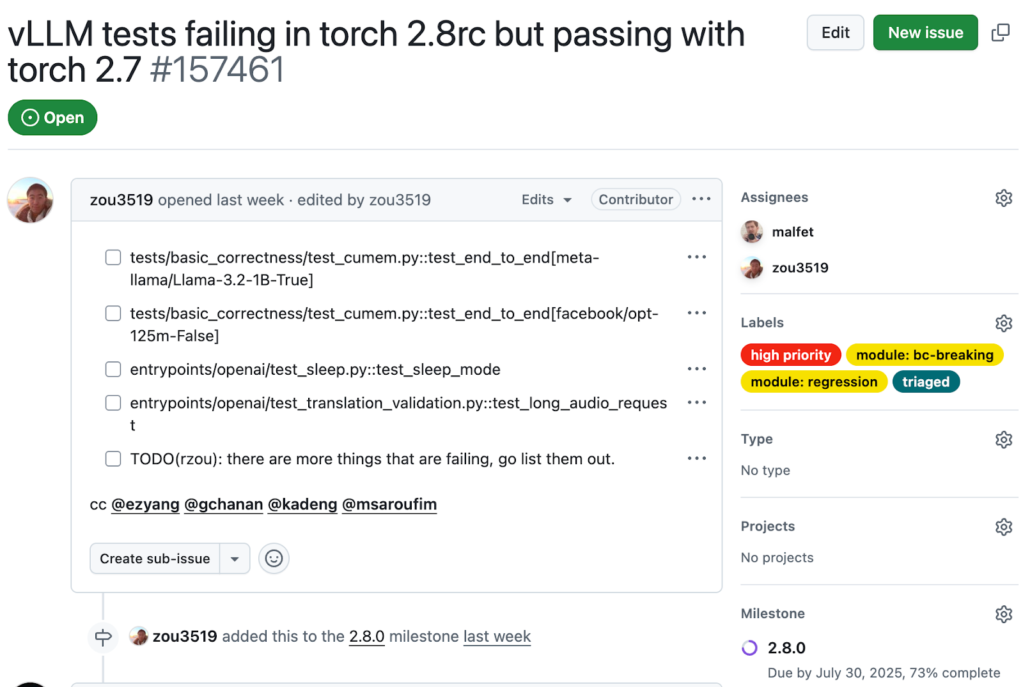
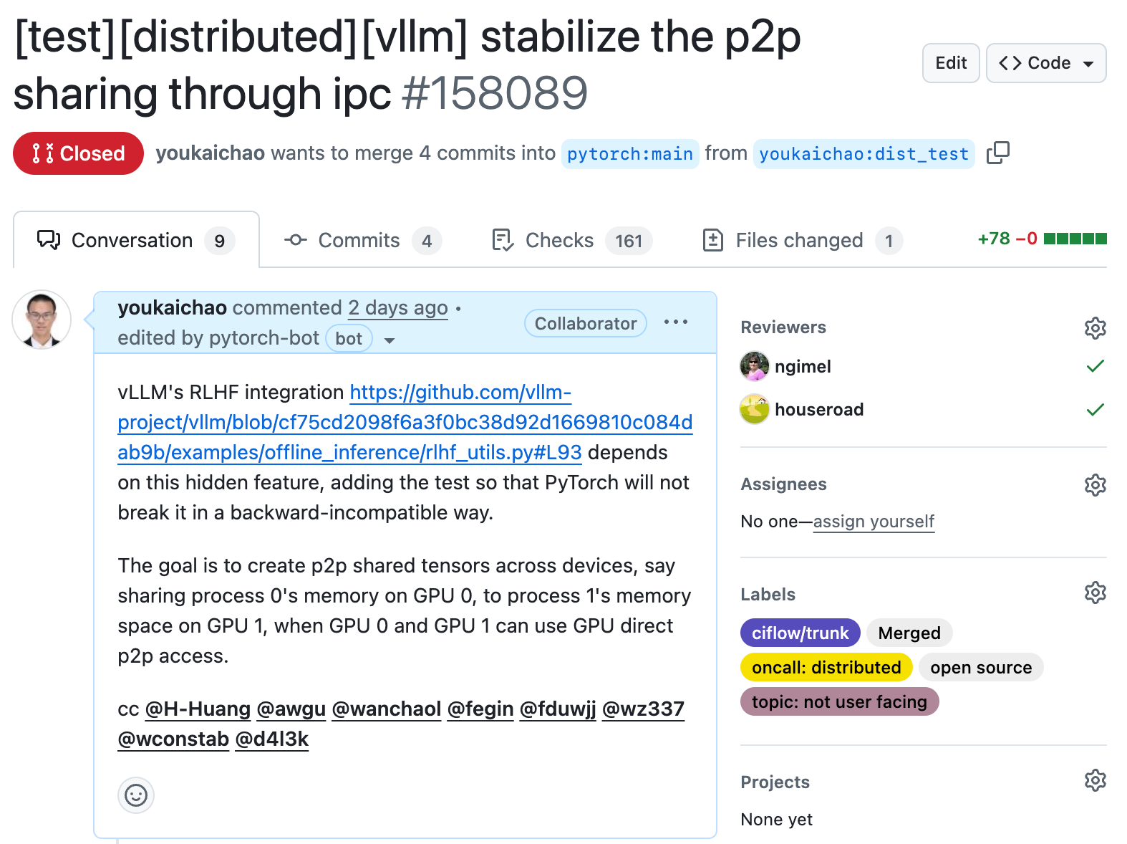
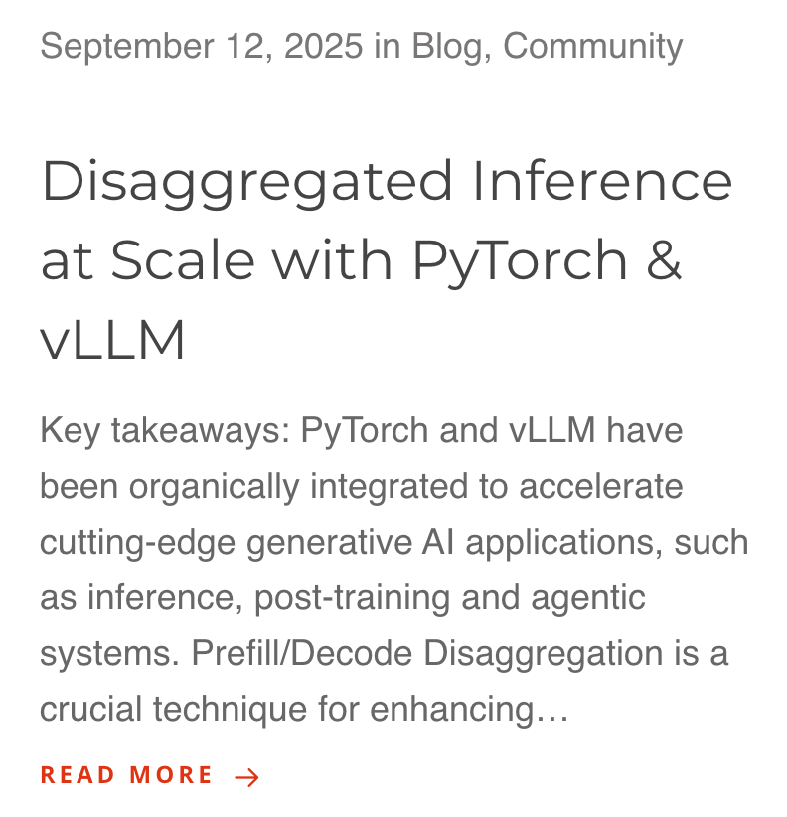
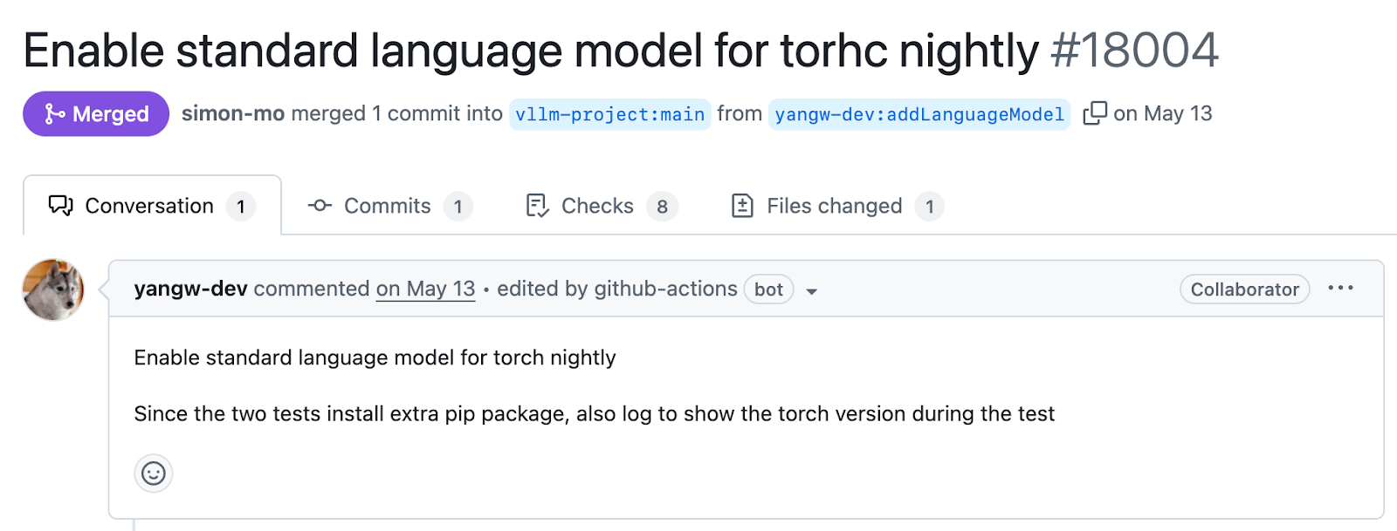
PyTorch + vLLM = ❤️

Slide 18
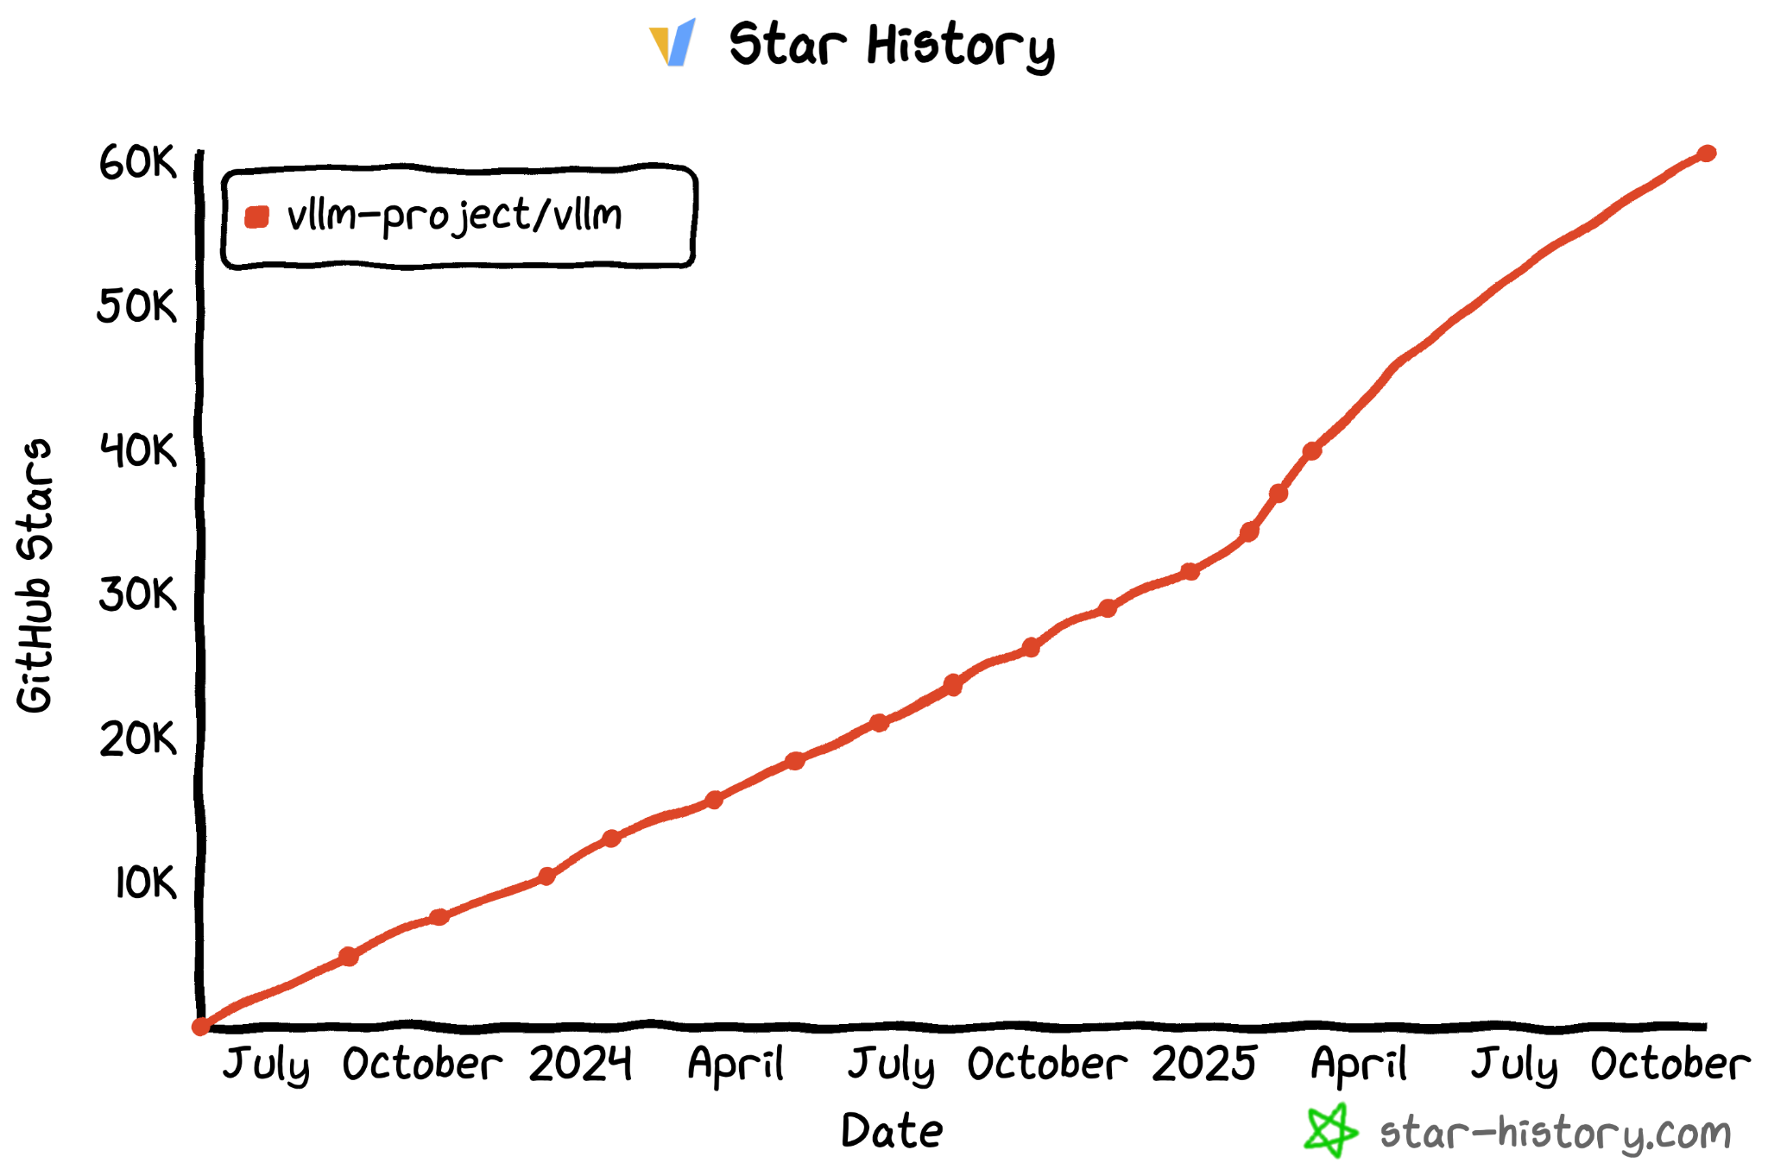
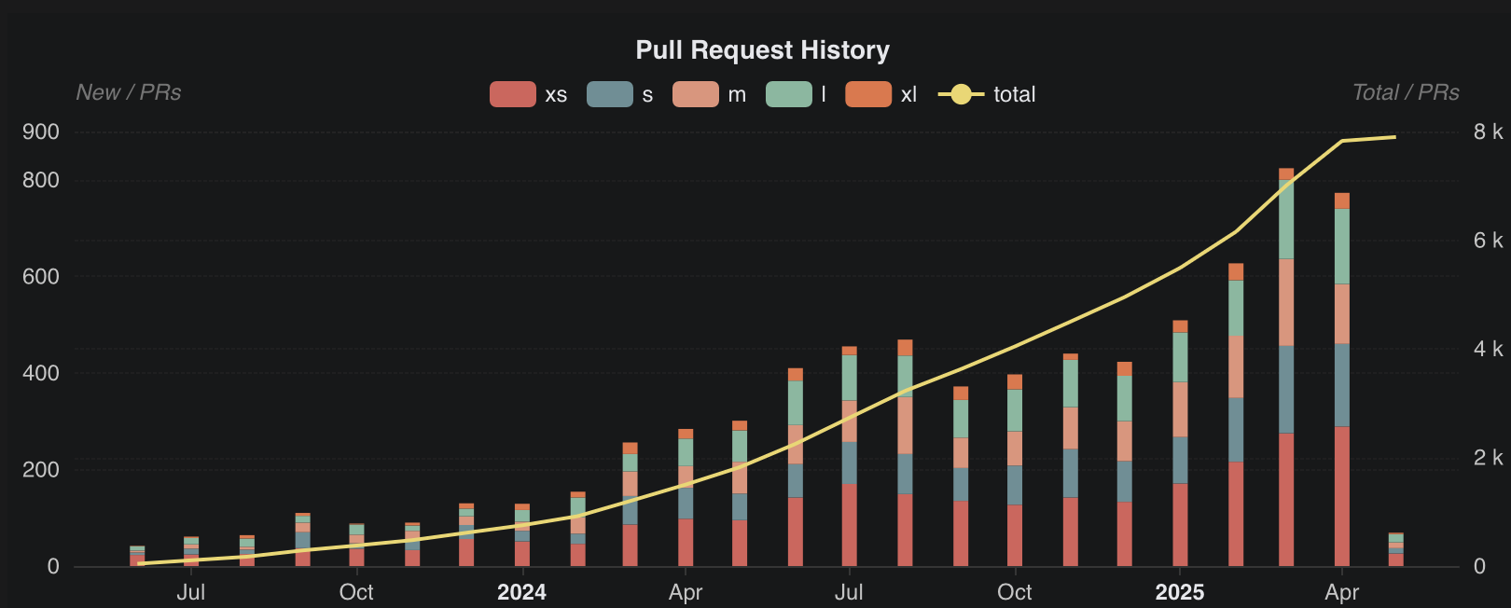
vLLM Adoption
Large-scale Collaborative Project
Most Popular LLM Inference Engine
800+ PRs per month
1700+ contributors
50+ major contributors from RedHat, Meta, Anyscale, HuggingFace, etc.
60K+ GitHub stars
500K++ GPUs deployed 24/7
9K members in slack.vllm.ai

Slide 19
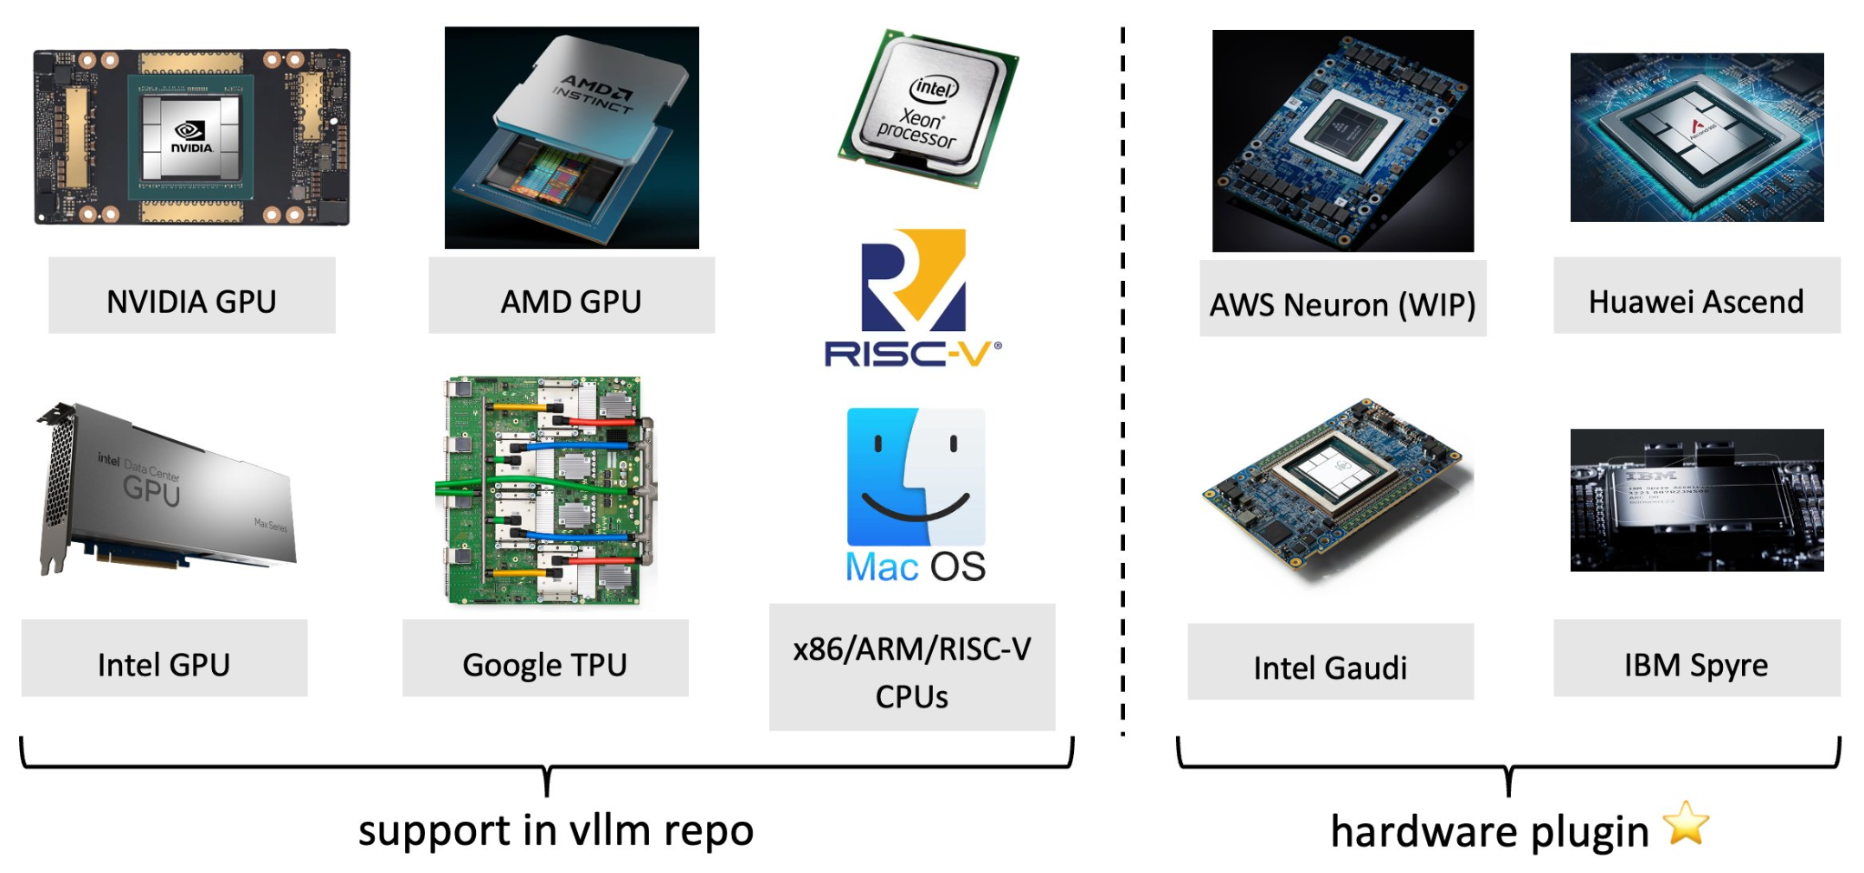
Diverse Hardware Support
+
MetaX
Rebellions
Cambricon
and more!!

Slide 20




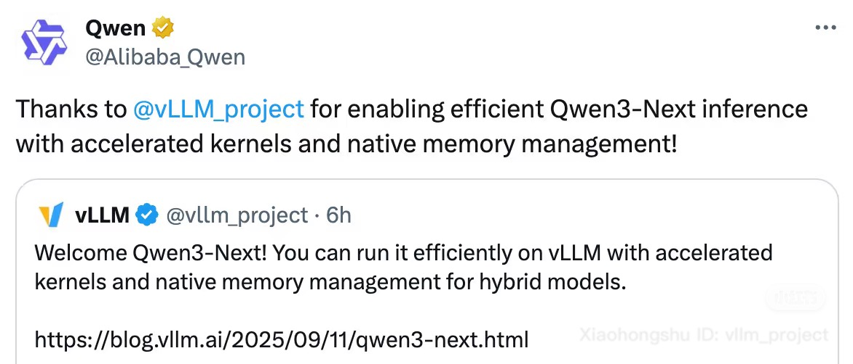


Broad Model Support
vLLM supports 100++ popular auto-regressive model architectures!
GPT-OSS
Llama
Qwen
DeepSeek
Gemma
Mistral
Molmo
Phi
Kimi-K2
Nemotron
Granite
GLM
…plus MANY more

Slide 21
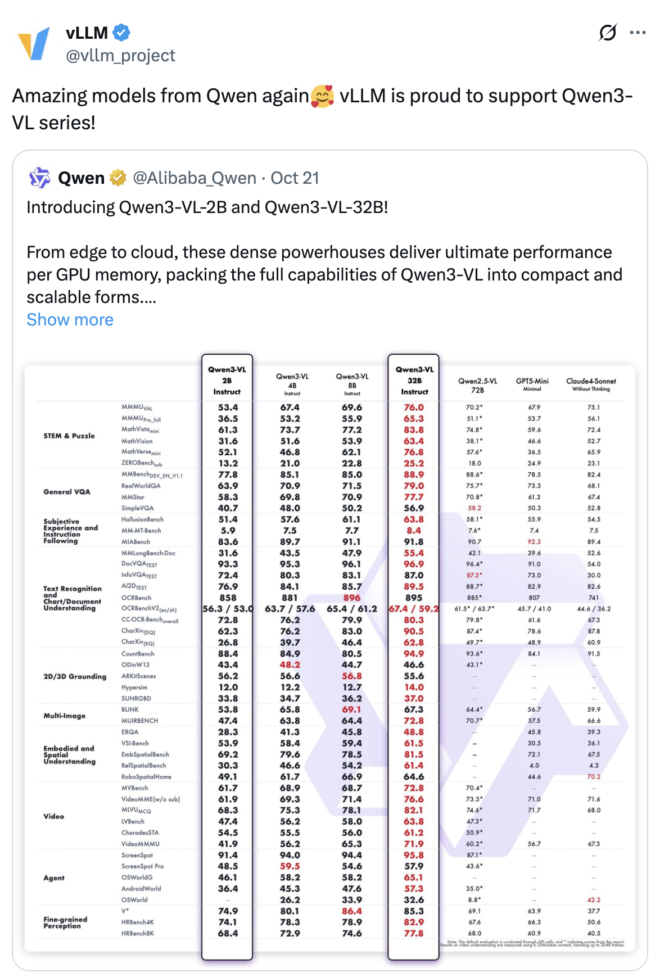
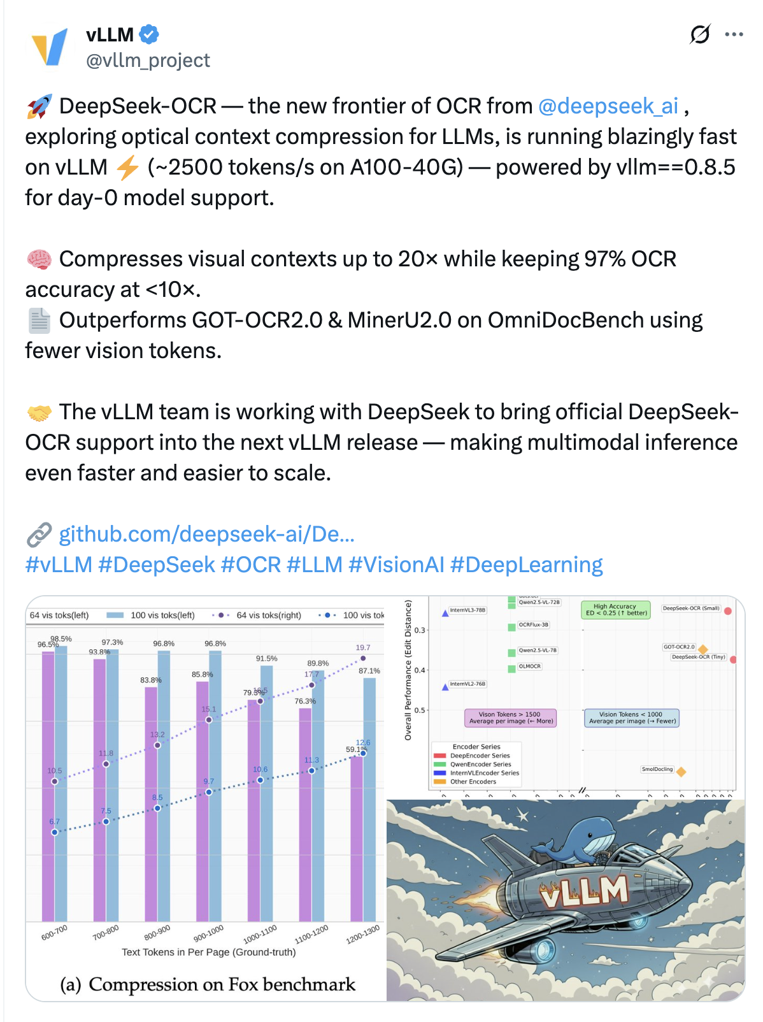
State of art vision model support

Slide 22
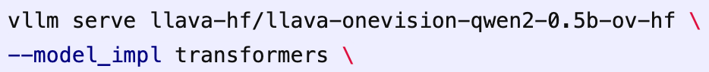
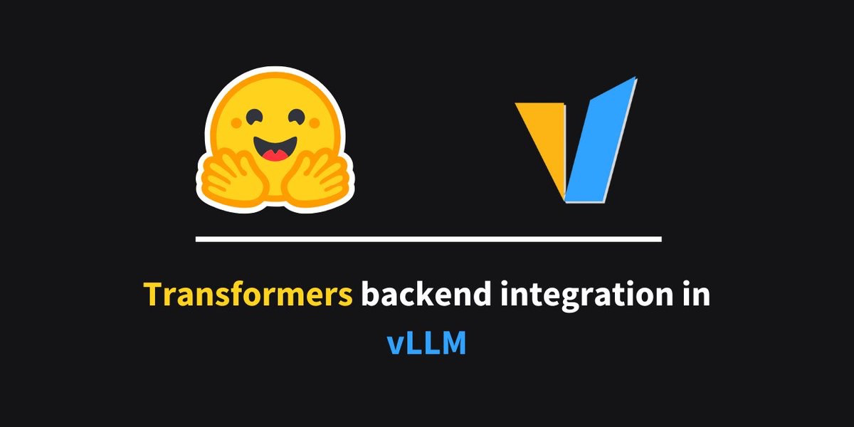
Transformers backend
Supports models not in vLLM, but runnable by Transformers
Write model implementation in Transformers
Leverage vLLM’s custom GEMM/Attention/MoE kernels, kv cache management, and continuous batching
Work for both vision and language models
Performance on par with pure vLLM implementation
https://blog.vllm.ai/2025/04/11/transformers-backend.html
Incoming 🔥 Transformers (5.0 release) + vLLM MoE, 24x faster
For model vendors who develop new models, it is recommended to use https://docs.vllm.ai/en/latest/contributing/model/registration.html#out-of-tree-models

Slide 23
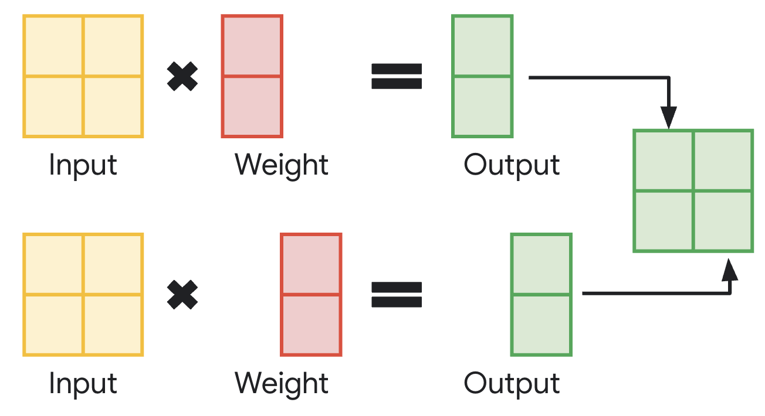
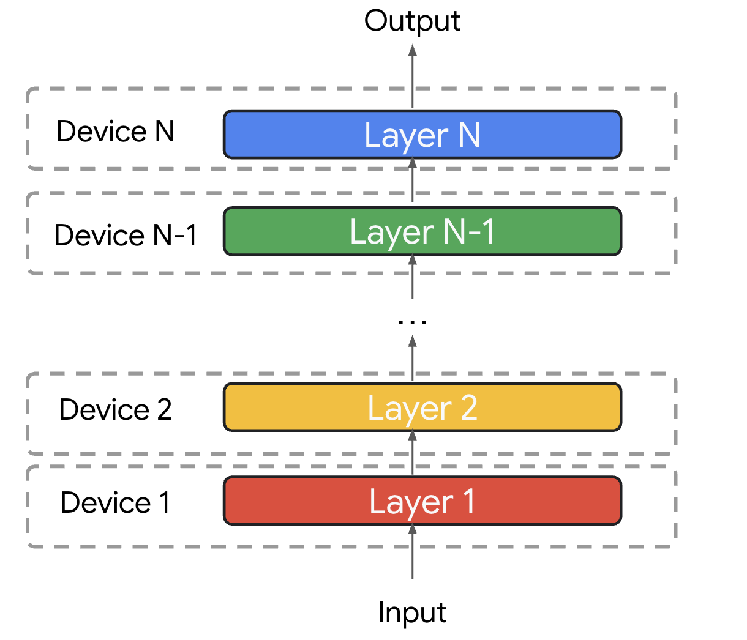
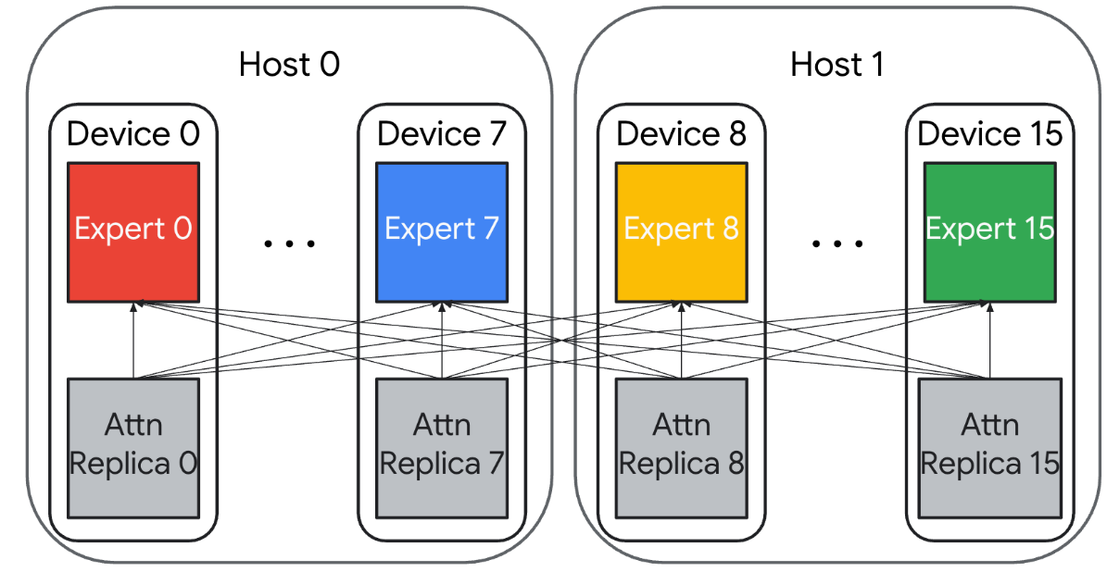
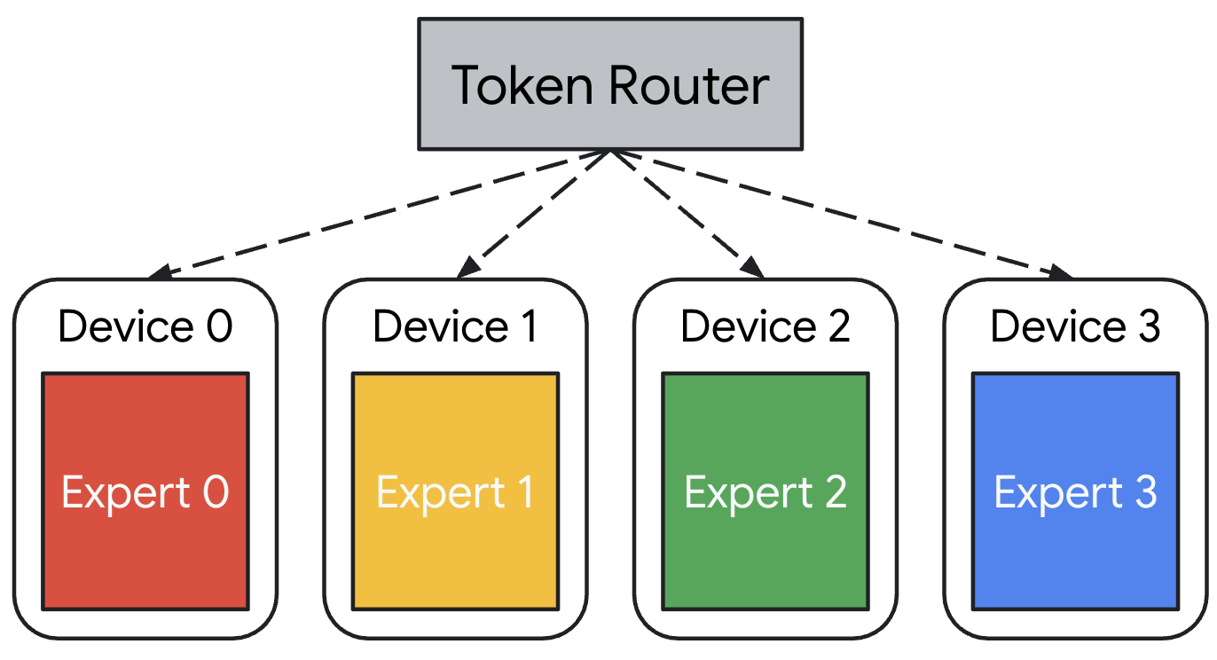
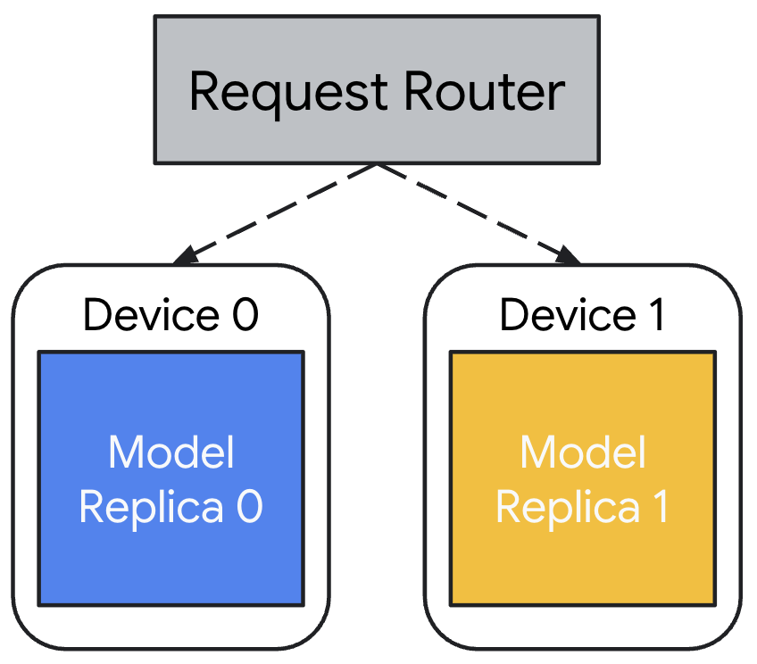
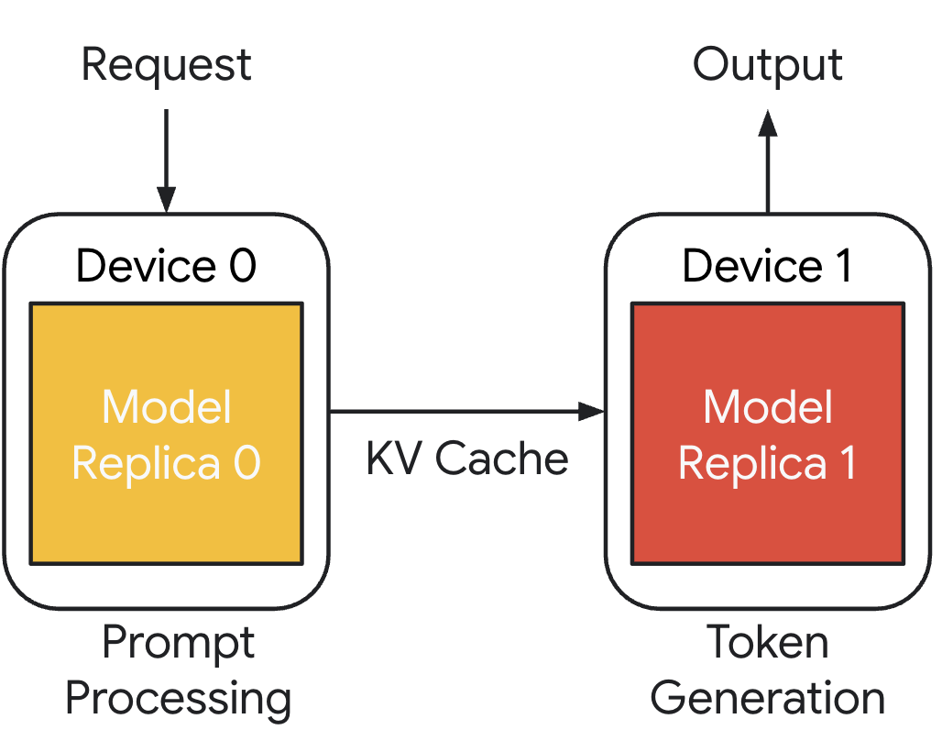
Forms of Parallelism in vLLM
Tensor Parallelism (TP)
Pipeline Parallelism (PP)
Mixed Parallelism
Expert Parallelism (EP)
Data Parallelism (DP)
Disaggregated P/D

Slide 24













Native Support for Reinforcement Learning

Slide 25
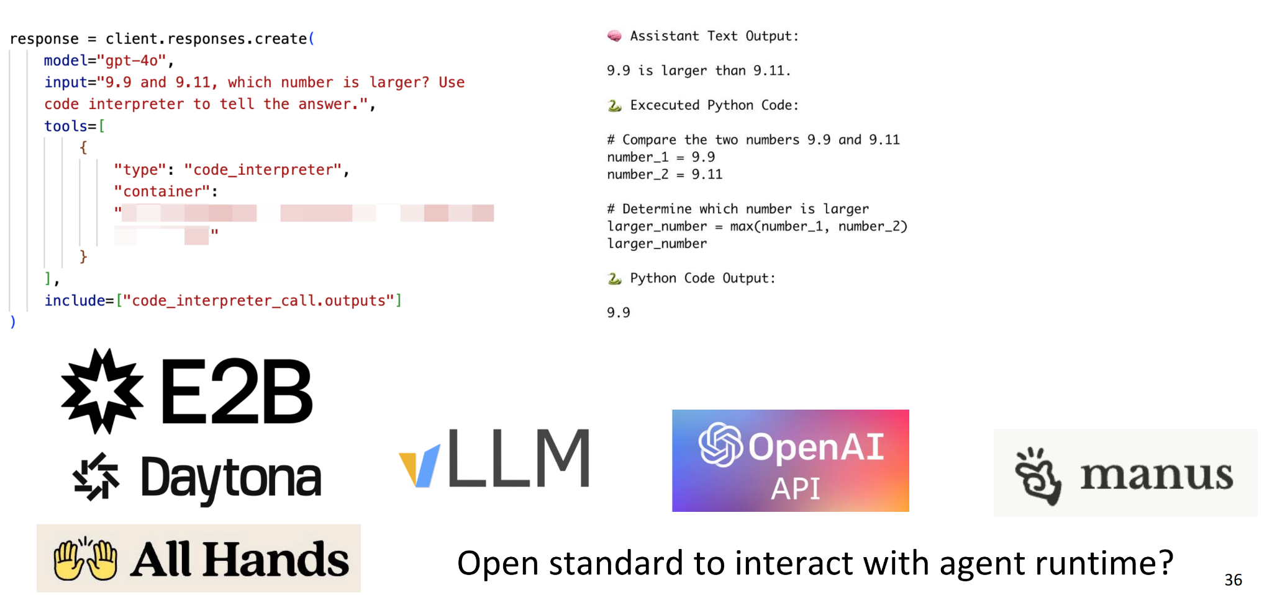
Embracing Agents: vLLM Stateful /v1/responses API

Slide 26
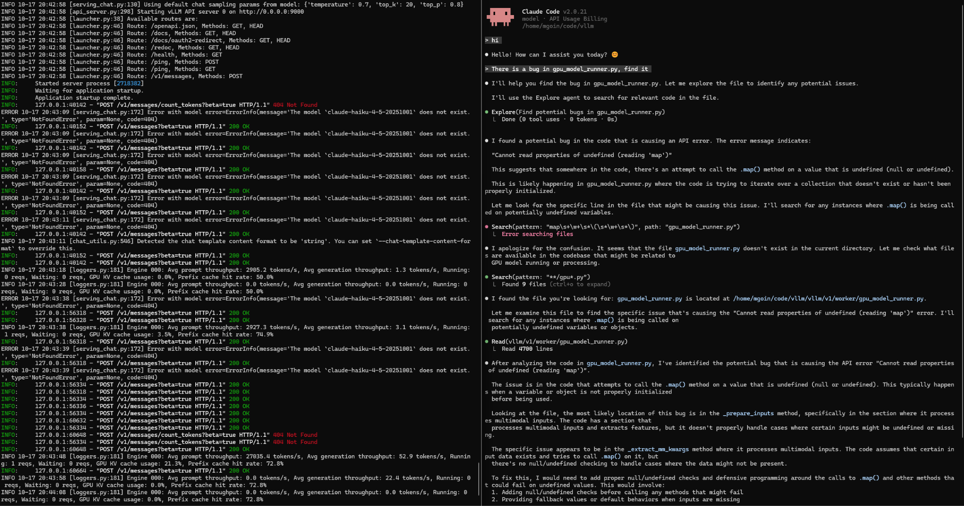
vLLM + Claude Code: Native /v1/messages API
Contribution welcome!

Slide 27
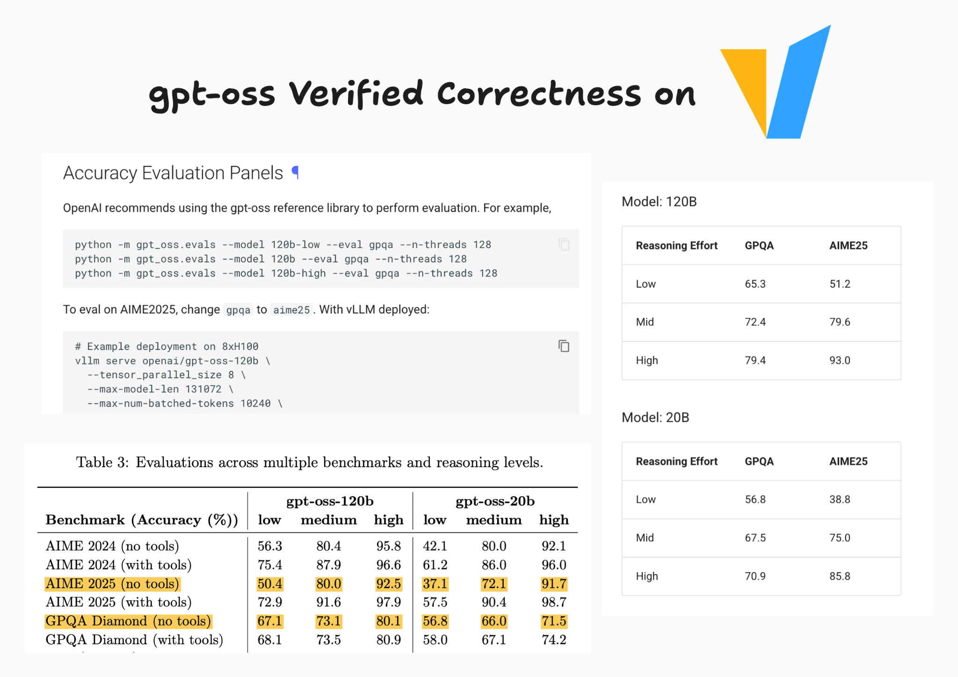
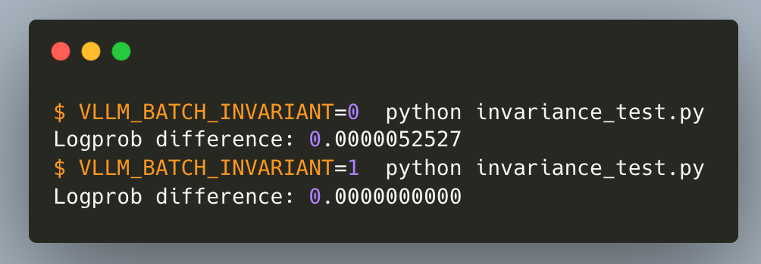
vLLM Prioritizes Accuracy

Slide 28
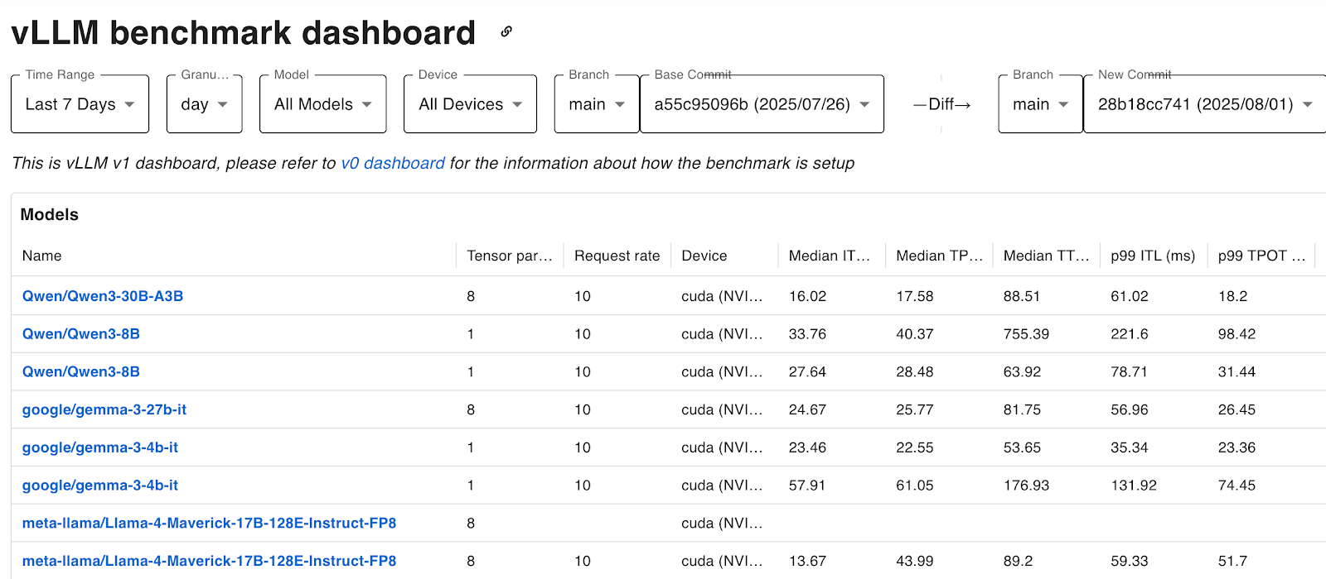
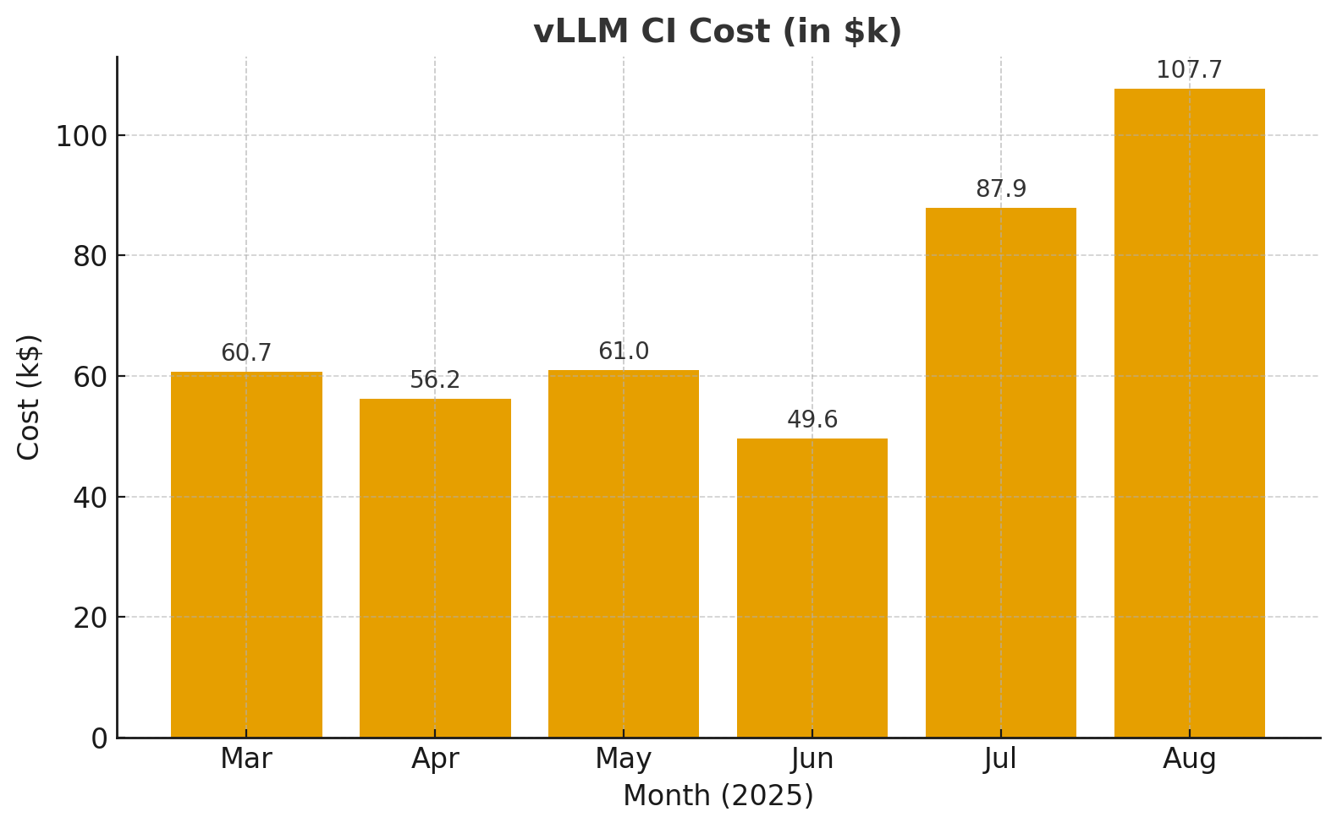
vLLM Prioritizes Performance
https://hud.pytorch.org/benchmark/llms?repoName=vllm-project%2Fvllm
Every commit is tested with thousands of tests
More than 100k$ / month spend on CI

Slide 29
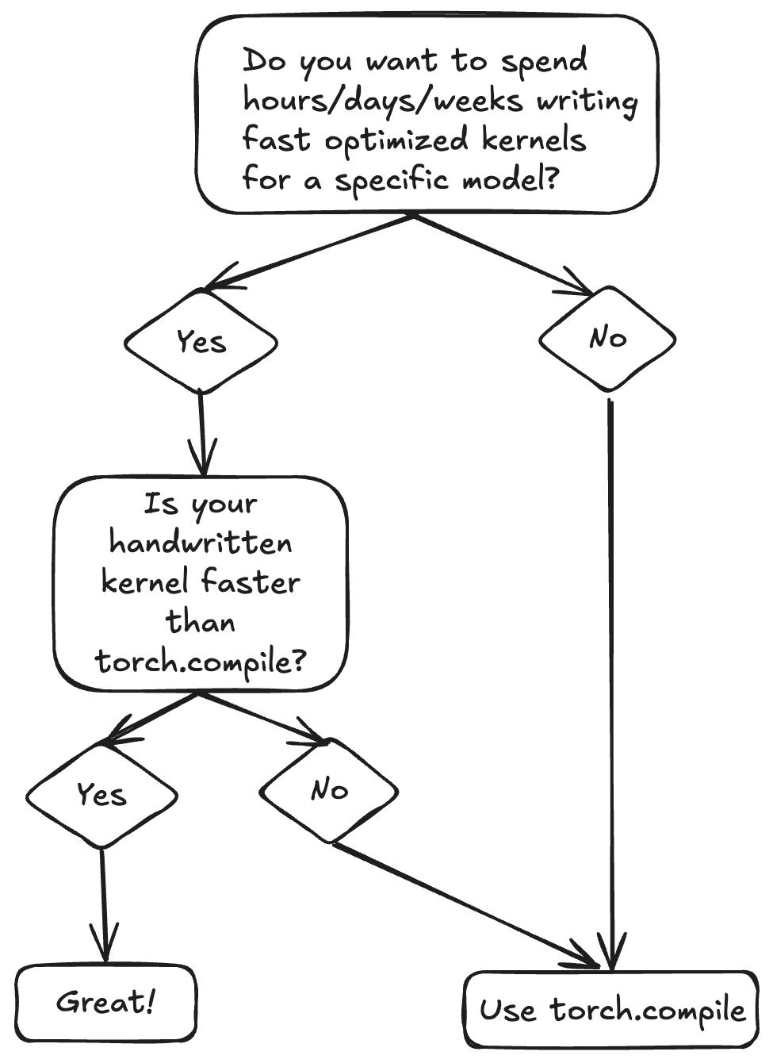
torch.compile 🤝 vLLM
Automatic kernel generation
Fast iteration, automatic fusion, performance portability
RoPE, RMSNorm, SiluMul, QuantFP8, etc.
Apply optimizations independently of model definitions
Graph-level transformations (Nanoflow, DBO)
Custom op and collective fusion passes
Attention + Quant (FP8) (~7% improvement)
Attention + Quant (FP4) (~11% improvement)
SiLU-Mul + Quant (FP4) (~3% improvement)
Sequence Parallelism & Async TP (~10% improvement)
AllReduce + RMSNorm + Quant (FP8) (~8% improvement)
AllReduce + RMSNorm + Quant (FP4) (~10% improvement)

Slide 30
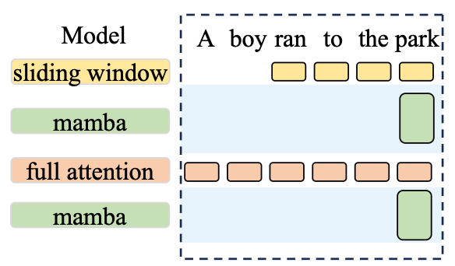
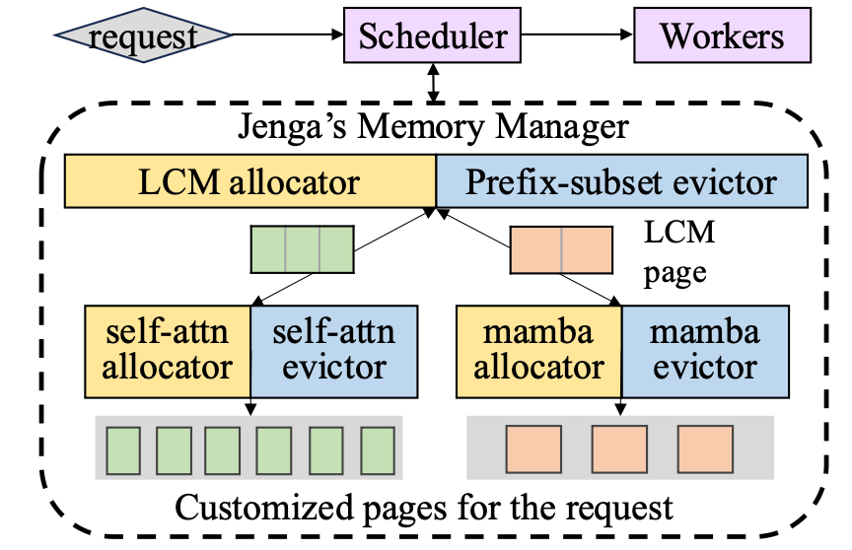



Hybrid Allocator
Long context models usually adopt a hybrid architecture, interleaving full attention and sliding window/linear/sparse attention. So how to manage the heterogeneity in memory management? → Introducing HybridKVCacheCoordinator
Chen Zhang, etc. Jenga: Effective Memory Management for Serving LLM with Heterogeneity, SOSP 2025

Slide 31
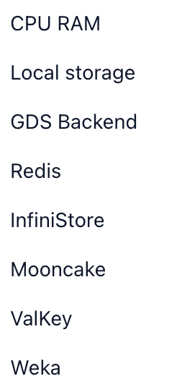
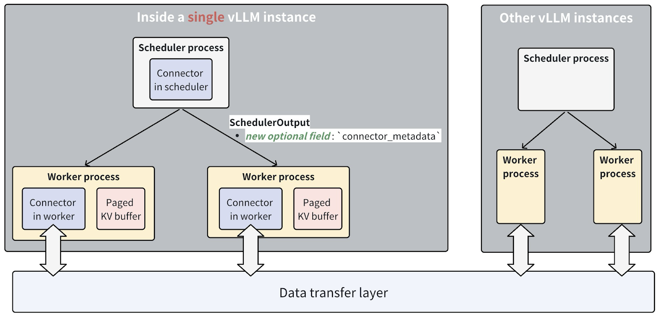

KV Connector
Flexible interface to interact with KV Cache inside vLLM, working with HybridKVCache
NIXL
SharedStorage
Custom KV connector is also supported for customizing the KV cache interaction.

Slide 32
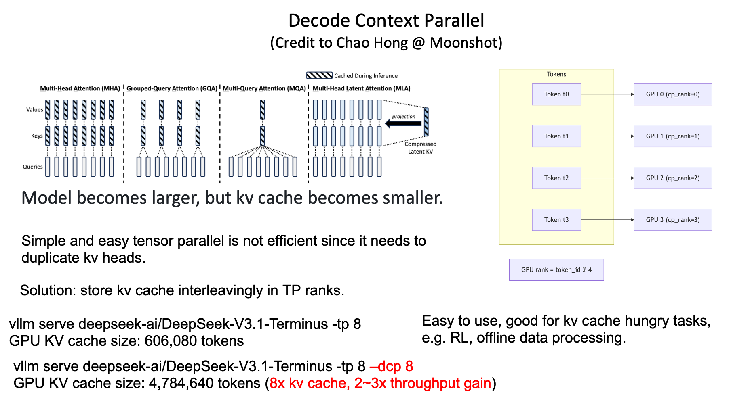

Decode Context Parallel

Slide 33
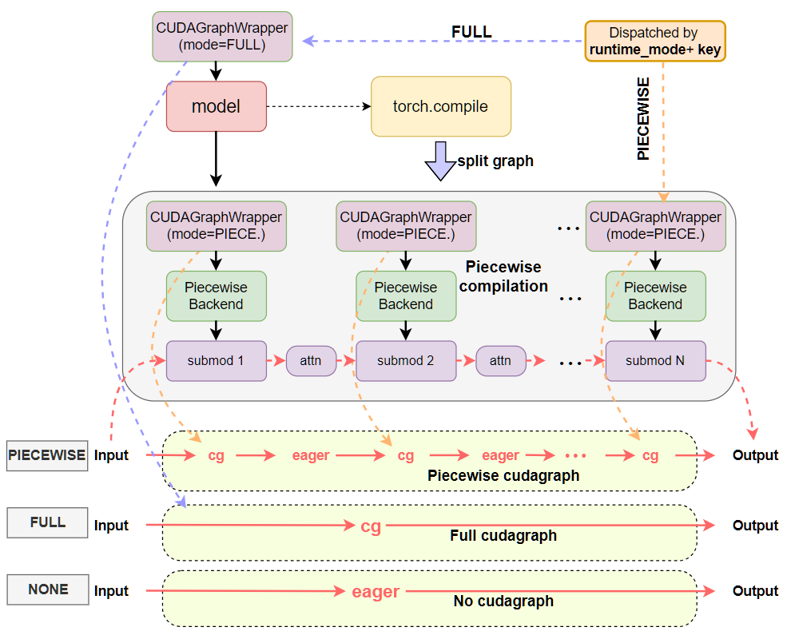
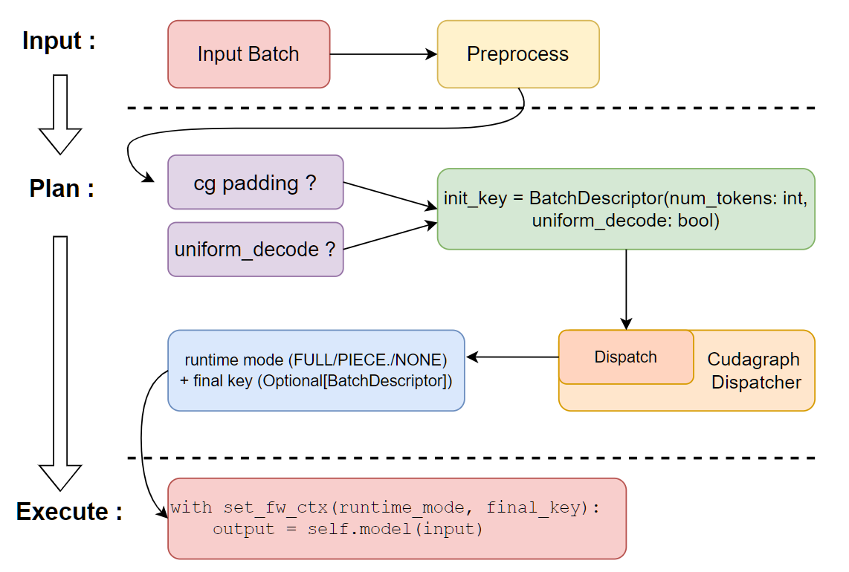
Flexible CUDAGraphs
https://docs.vllm.ai/en/latest/design/cuda_graphs.html

Slide 34
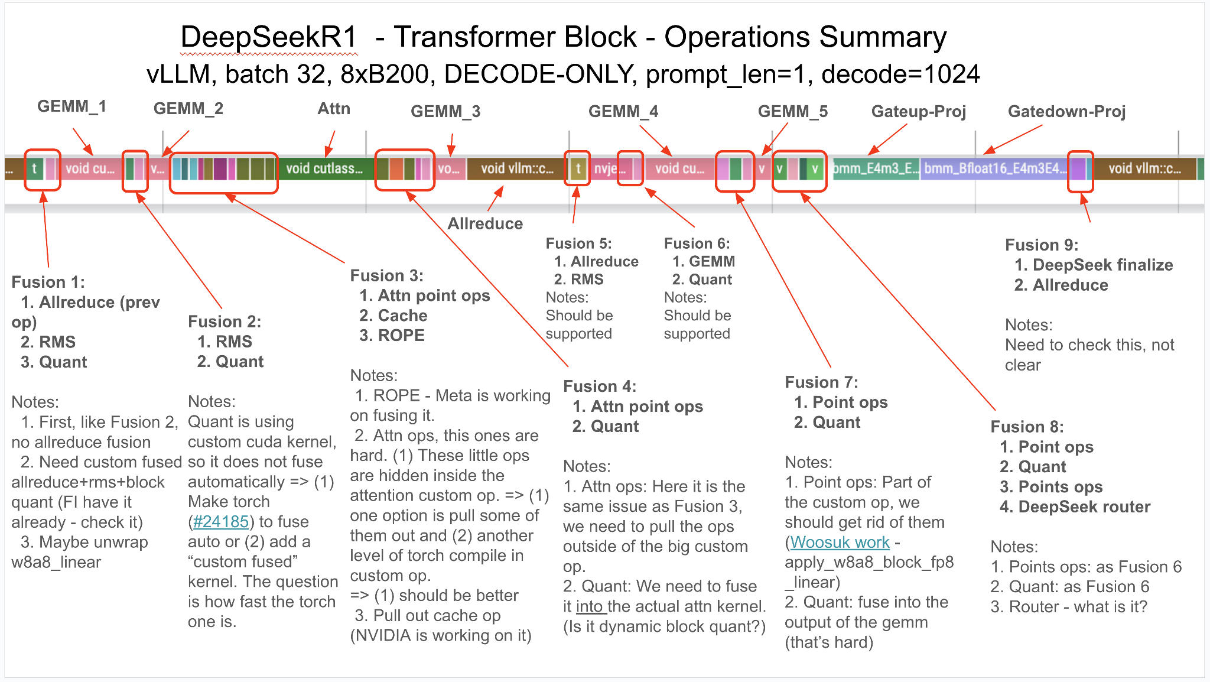
Model Bash
Unwrapping custom ops and enabling additional fusions inside the model forward pass
Join #sig-model-bash channel to help! (#24629)

Slide 35
vLLM Recap
Timely, accurate, and optimized model support
Wide hardware coverage
Flexible API with variety of integrations such as RL framework.
Deeply integrated and co-development with PyTorch
Frontier of innovations
Fused MoE Modular Kernel
torch.compile
Hybrid memory management
KV connectors
Fine-grained CUDAGraphs
Aggressive operator fusion
Large-scale production distributed inference
…

Slide 36
From Beginner to Advanced Quantization in vLLM
Eldar Kurtić
Principal Research Scientist, Red Hat AI
Dan Alistarh
Professor at ISTA & Researcher, Red Hat AI

Slide 37
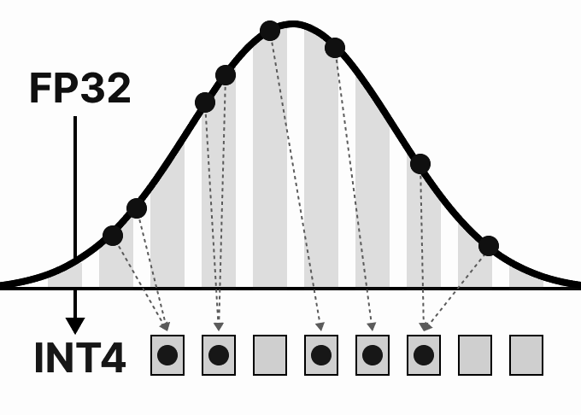
Is there such a thing as lossless LLM quantization?

Slide 38
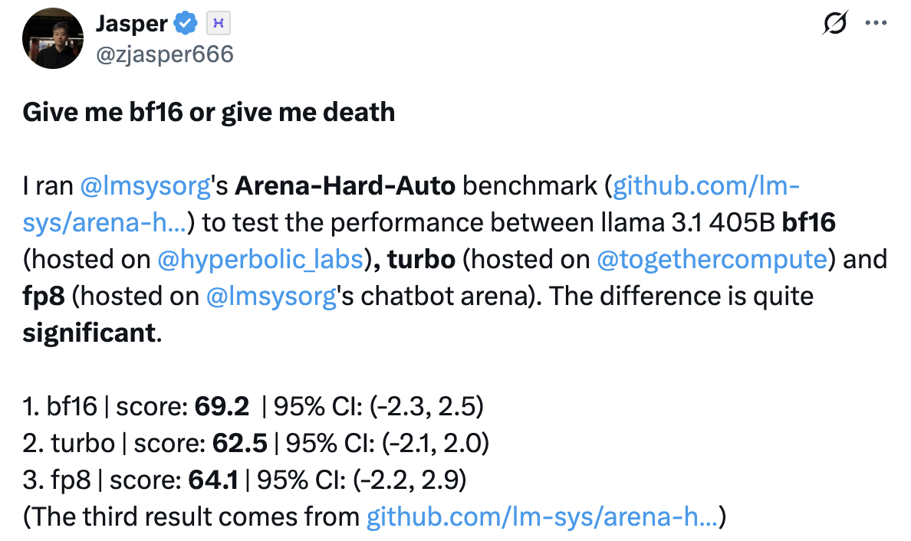
Is there such a thing as lossless LLM quantization?

Slide 39
Is there such a thing as lossless LLM quantization?
1. Not all quantized models are created equal!

Slide 40
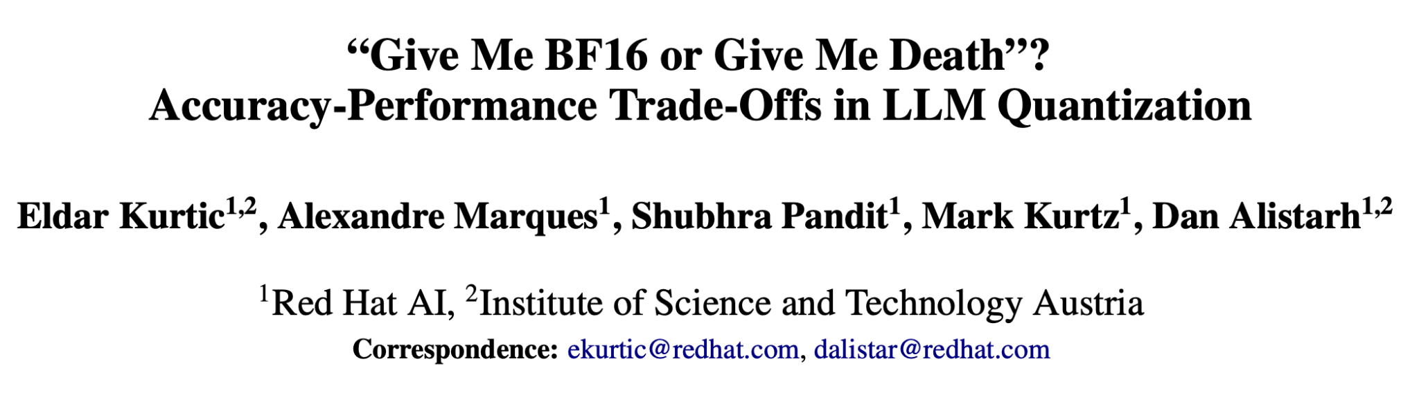
Is there such a thing as lossless LLM quantization?
https://arxiv.org/pdf/2411.02355
More than 1M evaluations across Open-LLM Leaderboard v1/v2, reasoning, long context, arena-hard, coding, multimodal, …

Slide 41
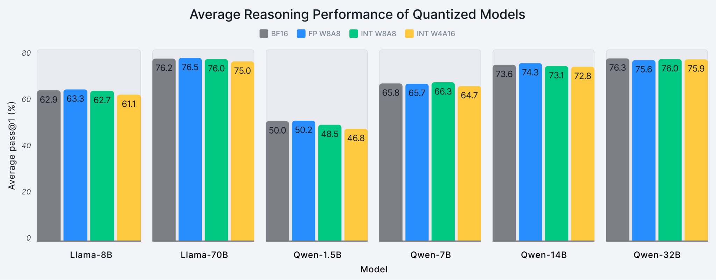
Reasoning performance = average pass@1 score on AIME24, MATH-500, and GPQA-Diamond
Models = DeepSeek-R1-Distill-{Llama, Qwen}

Slide 42
Reasoning performance = average pass@1 score on AIME24, MATH-500, and GPQA-Diamond
Models = DeepSeek-R1-Distill-{Llama, Qwen}
65.8 vs 74.3 / 73.1 / 72.8

Slide 43
Reasoning performance = average pass@1 score on AIME24, MATH-500, and GPQA-Diamond
Models = DeepSeek-R1-Distill-{Llama, Qwen}
65.8 vs 74.3 / 73.1 / 72.8
2. Larger quantized is always better than smaller unquantized.

Slide 44
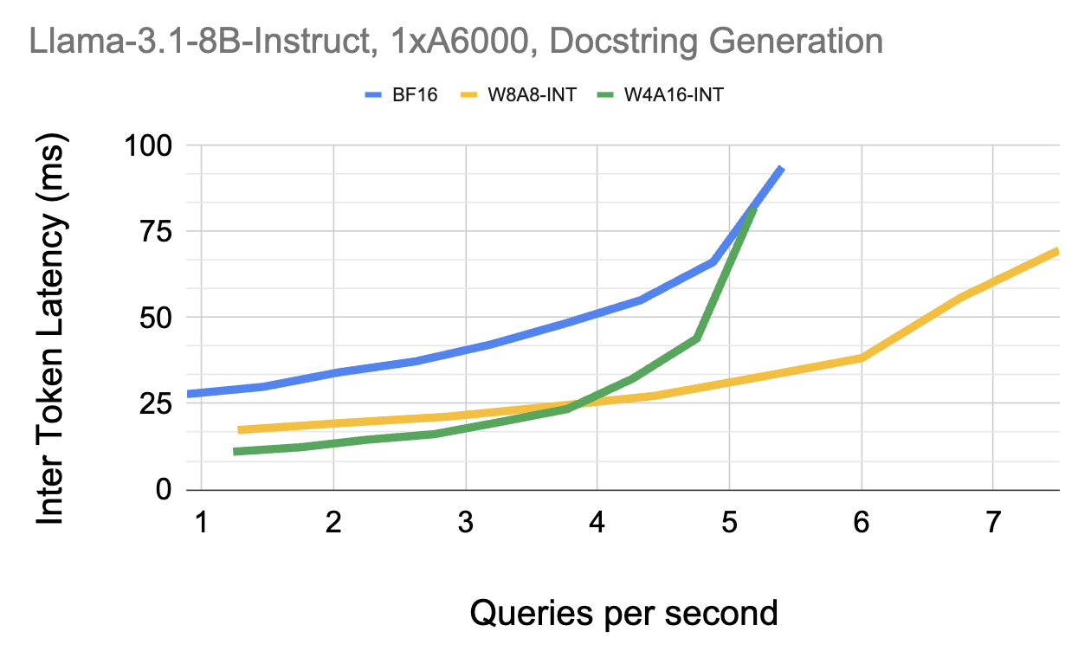

Slide 45
W4A16

Slide 46
W8A8 > W4A16

Slide 47
BF16 > W4A16

Slide 48
BF16 > W4A16
3. No golden bullets, understand your deployment.
W8A8 > W4A16
W4A16

Slide 49
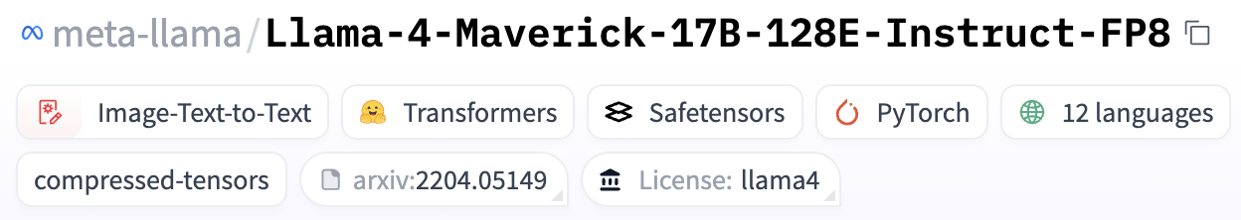
How to quantize? → LLM-Compressor https://github.com/vllm-project/llm-compressor
How to benchmark? → GuideLLM https://github.com/vllm-project/guidellm
Where to find high-quality quantized models? → Red Hat AI’s Hub https://huggingface.co/RedHatAI
What next? → Speculative Decoding https://github.com/vllm-project/speculators → New FP4 formats https://github.com/IST-DASLab/qutlass

Slide 50
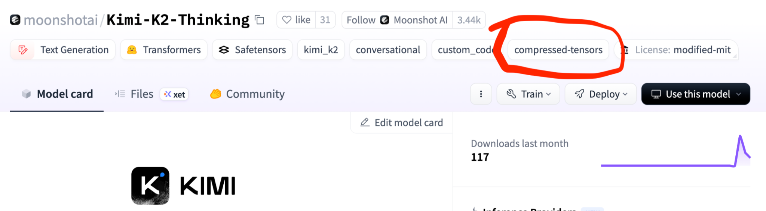

Slide 51
A bit of research: FP8/INT8 weights-and-acts is near-lossless. How about going lower?

Slide 52
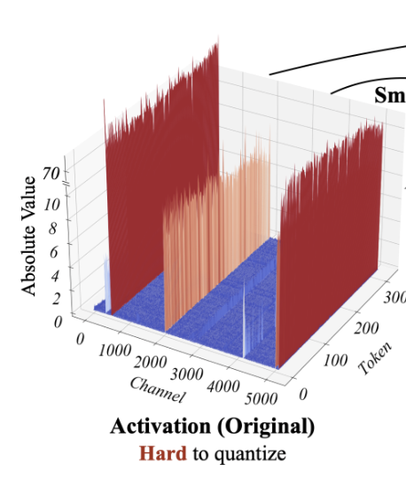
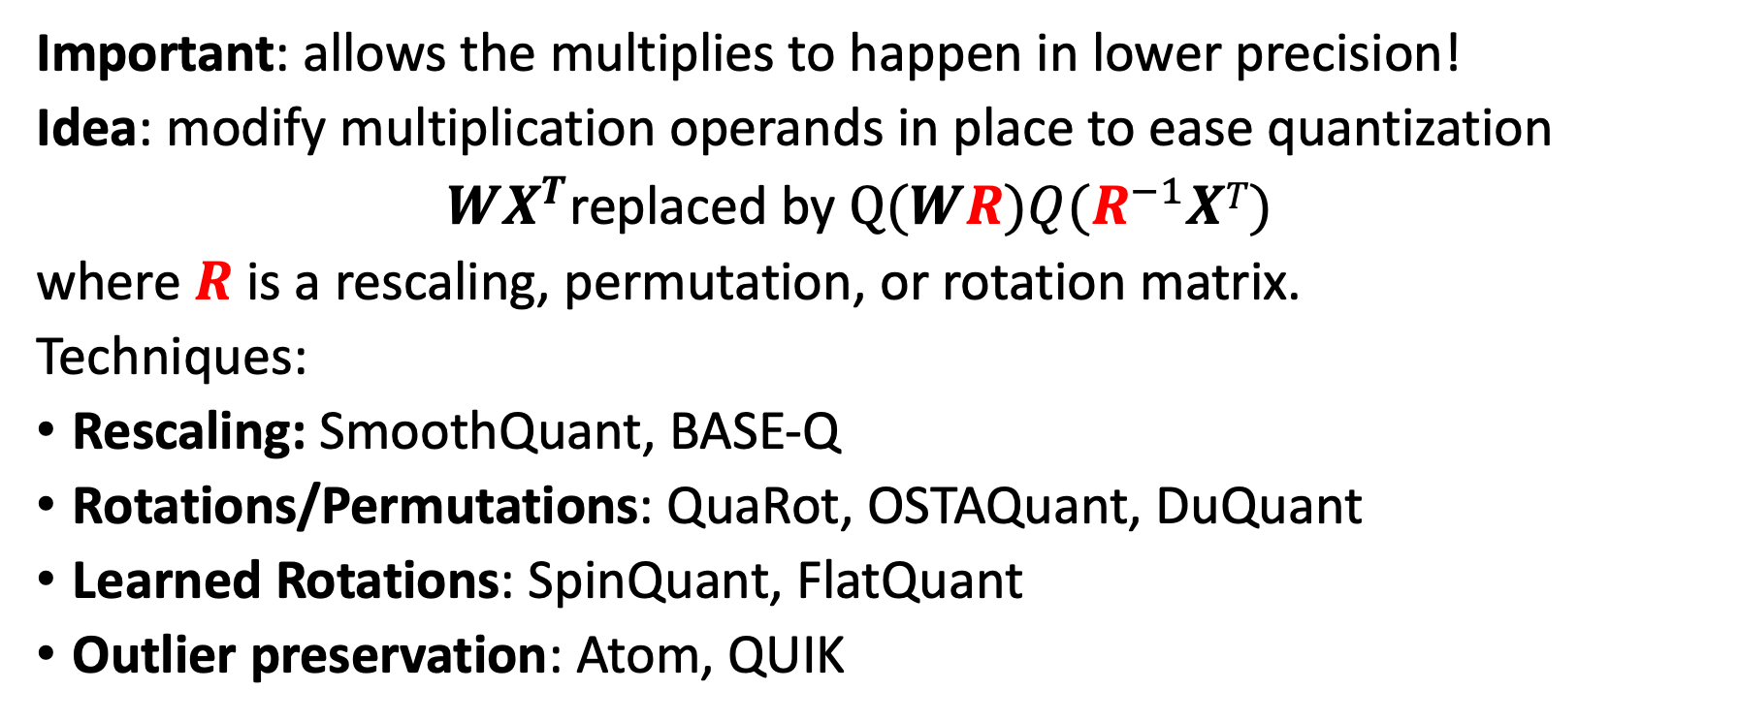
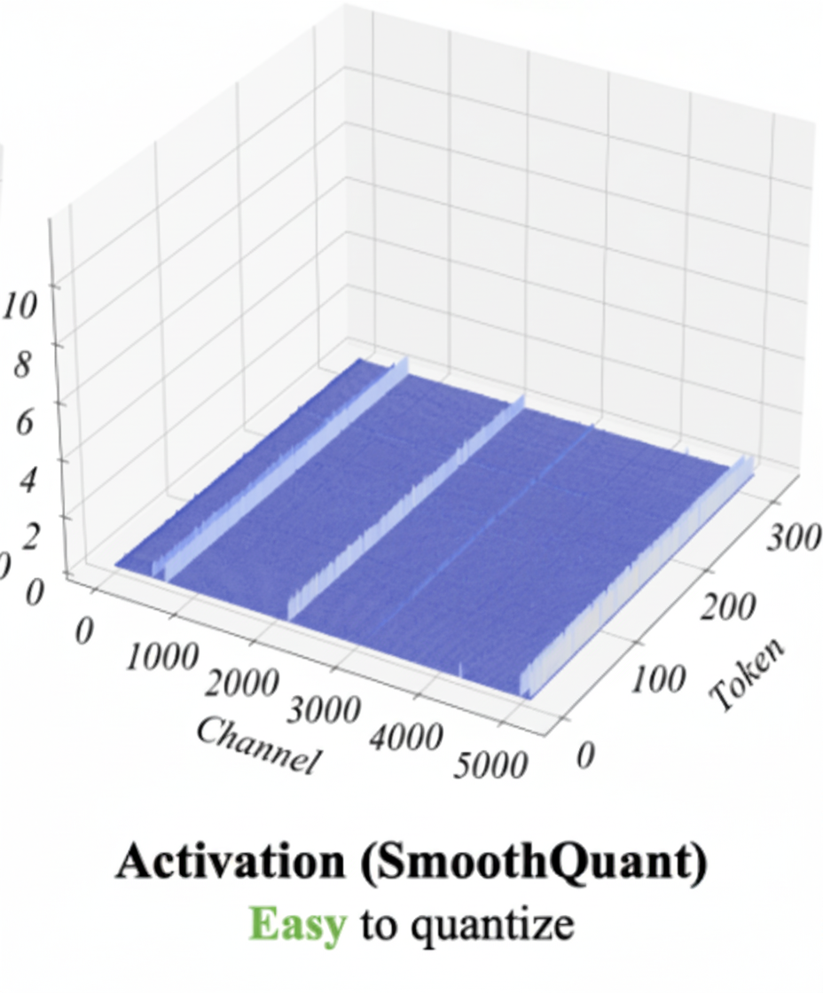
The Frontier: Weights-AND-Activations in 4 Bits
Source: SmoothQuant

Slide 53
The Frontier: Weights-AND-Activations in 4 Bits
Source: SmoothQuant
Issue: Existing techniques “break” when going to INT4 weights and activations (<95% accuracy recovery).

Slide 54
There are limits to what is achievable with INT4. What if we changed formats?

Slide 55
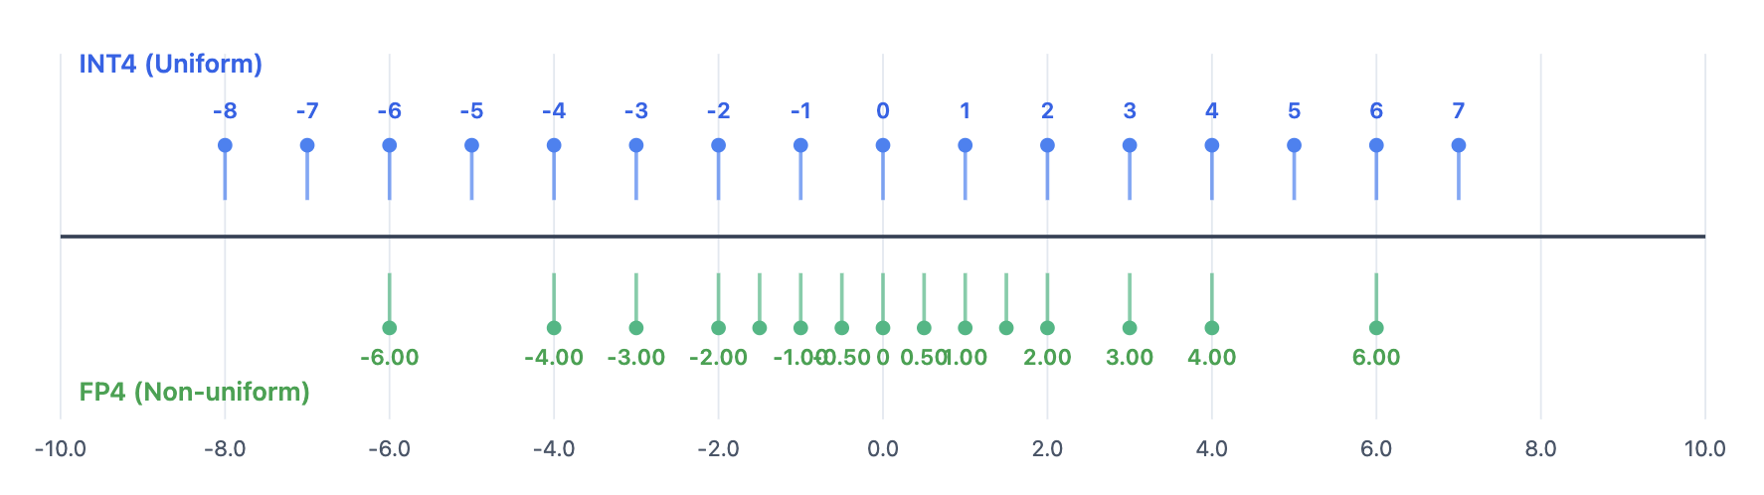
“Microscaling” NVFP4 & MXFP4
Different grid:
Denser towards zero
Larger gaps towards large values
Intuition: better for outliers

Slide 56
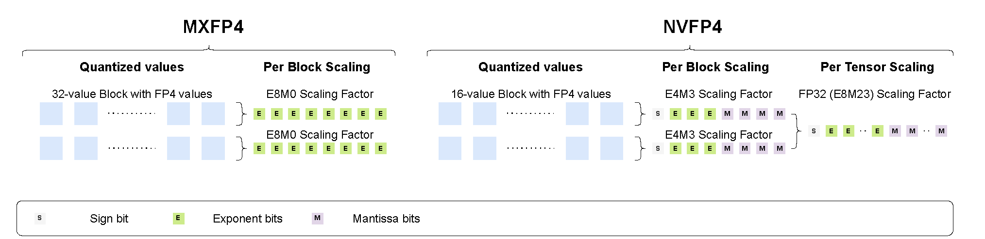
“Microscaling” NVFP4 & MXFP4
Different grid:
Denser towards zero
Larger gaps towards large values
Intuition: better for outliers
Microscaled quantization:
In small groups (16 for NVFP, 32 for MXFP)
Scales themselves quantized
E4M3 for NVFP, E8M0 for MXFP
NVFP4: 1/16 outliers “preserved” in FP8

Slide 57
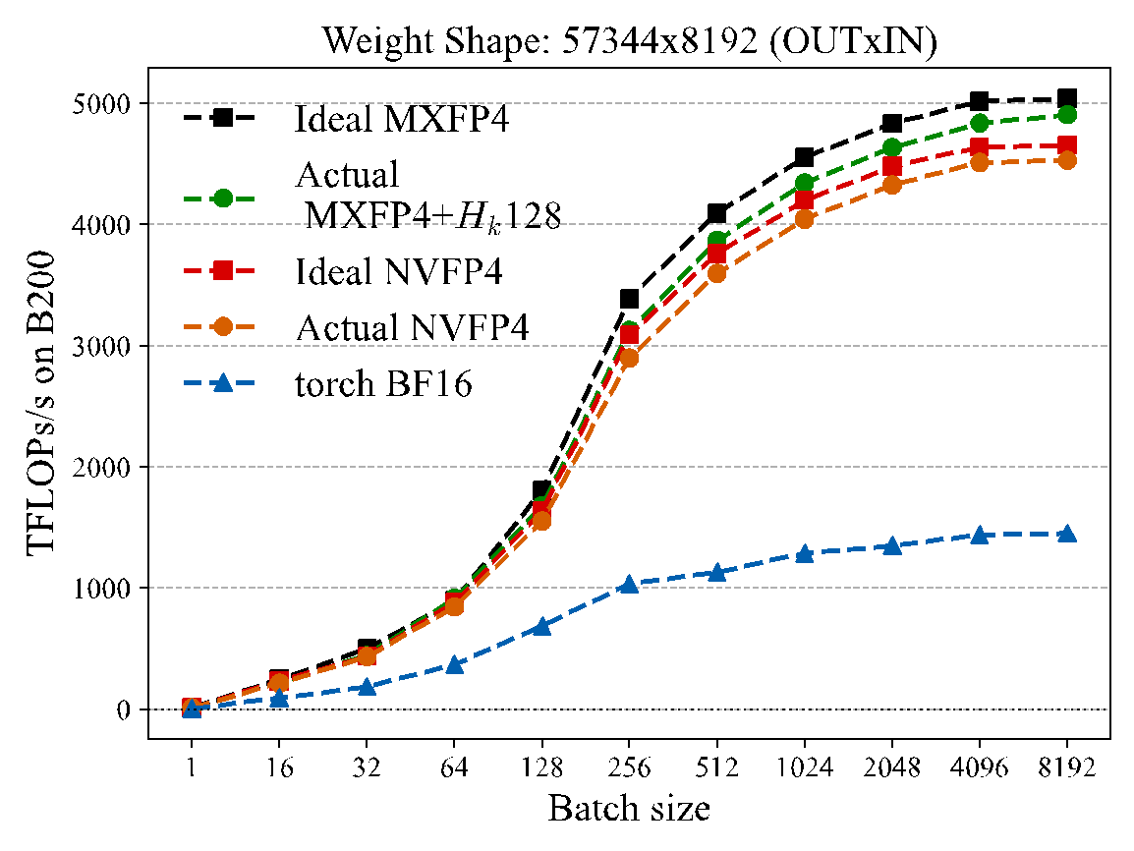
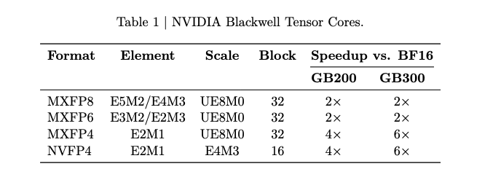
“Microscaling” NVFP4 & MXFP4
Different grid:
Denser towards zero
Larger gaps towards large values
Intuition: better for outliers
Microscaled quantization:
In small groups (16 for NVFP, 32 for MXFP)
Scales themselves quantized
E4M3 for NVFP, E8M0 for MXFP
NVFP4: 1/16 outliers “preserved” in FP8
Fast computational support:
Versus FP16: 4x on B200, 6x on B300
Source: NVIDIA FP4 Training paper.

Slide 58
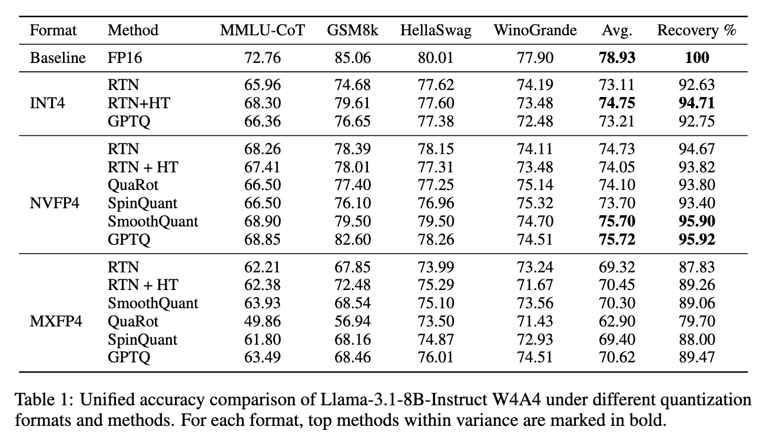
Do Microscaling Formats Help?
Initial experiment:
Weights-and-activation quantization
NVFP4, MXFP4, INT4 (GS32, simulated)
Llama-3.1-8B Instruct
Standard evaluations

Slide 59
Do Microscaling Formats Help?
Initial experiment:
Weights-and-activation quantization
NVFP4, MXFP4, INT4 (GS32, simulated)
Llama-3.1-8B Instruct
Standard evaluations
Findings in short:
1. No format is lossless: even with advanced techniques, we still drop 4-5%. 2. NVFP4 is the best, INT4 is close second, and MXFP4 is terrible.
3. Rotations (HT) don’t help NVFP4, but they help INT4 and MXFP4 a lot.
4. SmoothQuant and GPTQ help a bit.

Slide 60








Can We Do Better?
[MR-GPTQ: Castro, Egiazarian et al., 2025. Paper: https://arxiv.org/pdf/2509.23202 ]
Micro-Rotated GPTQ (MR-GPTQ)
- Micro-rotations: “smoothen” the group-level weight distribution
- Error correction: Initially, worse MSE but better recovery overall thanks to FP-specific GPTQ improvements
- Rotation Fusion: Micro-rotations applied into weights at pre-processing, and applied online onto activations, during quantization
Small
Block Hadamard
Activations
Rotated Acts.
Weights
Rotated W.
MR-GPTQ
MR-GPTQ Variants

Slide 61
Can We Do Better?
[MR-GPTQ: Castro, Egiazarian et al., 2025. Paper: https://arxiv.org/pdf/2509.23202 ]
Micro-Rotated GPTQ (MR-GPTQ)
- Micro-rotations: “smoothen” the group-level weight distribution
- Error correction: Initially, worse MSE but better recovery overall thanks to FP-specific GPTQ improvements
- Rotation Fusion: Micro-rotations applied into weights at pre-processing, and applied online onto activations, during quantization
Small
Block Hadamard
Activations
Rotated Acts.
Weights
Rotated W.
MR-GPTQ
MR-GPTQ Variants
MR-GPTQ currently provides SOTA accuracy for both NVFP4 (97-99% recovery) and MXFP4 (94-98%).
The same trend works for weight-only quantization (>99% recovery).

Slide 62


But, is it Fast?
https://github.com/IST-DASLab/QuTLASS
Speedup results for single-layer and end-to-end inference:
Roberto L. Castro ISTA/RedHat AI

Slide 63
But, is it Fast?
https://github.com/IST-DASLab/QuTLASS
Speedup results for single-layer and end-to-end inference:
Roberto L. Castro ISTA/RedHat AI
Notes:
- MR-GPTQ format supported in vLLM, llm-compressor support almost there
- Micro-rotations can be fast across all GPUs (RTX 5090 and B200), even at size 128x128
- MXFP slightly faster than NVFP (20%) :-)

Slide 64
Training Reasoning Models Using vLLM
Patrick von Platen, Research Engineer, Mistral
Julien Denize, Open Source Engineer, Mistral

Slide 65
Training reasoning models using vLLM
Julien Denize & Patrick von Platen

Slide 66


Magistral Medium
Joint work with:
Abhinav Rastogi, Andy Lo, Gabrielle Berrada, Guillaume Lample, Jason Rute, Joep Barmentlo, Karmesh Yadav, Kartik Khandelwal, Khyathi Raghavi Chandu, Léonard Blier, Lucile Saulnier, Matthieu Dinot, Maxime Darrin, Neha Gupta, Roman Soletskyi, Sagar Vaze, Teven Le Scao, Yihan Wang

Slide 67

Large reasoning models

Slide 68
Large reasoning models - Spelled out
1. Sample N prompts:
“What is 2 + 2?”,
“Sort [1, 6, 4, 3]”

Slide 69
Large reasoning models - Spelled out
1. Sample N prompts:
“What is 2 + 2?”,
“Sort [1, 6, 4, 3]”
2. Generate M answers per prompt
“2 + 2 = 5”, “2 plus 2 equals 4”, “2 + 2 + 2 + …”
“The sorted list is [1, 3, 4, 6]”, “[1, 3, 4, 6]”, …

Slide 70
Large reasoning models - Spelled out
1. Sample N prompts:
“What is 2 + 2?”,
“Sort [1, 6, 4, 3]”
2. Generate M answers per prompt
“2 + 2 = 5”, “2 plus 2 equals 4”, “2 + 2 + 2 + …”
“The sorted list is [1, 3, 4, 6]”, “[1, 3, 4, 6]”, …
3. Verify each answer
“2 + 2 = 5” => 0; “2 plus 2 equals 4” => 1.0

Slide 71
Large reasoning models - Spelled out
1. Sample N prompts:
“What is 2 + 2?”,
“Sort [1, 6, 4, 3]”
2. Generate M answers per prompt
“2 + 2 = 5”, “2 plus 2 equals 4”, “2 + 2 + 2 + …”
“The sorted list is [1, 3, 4, 6]”, “[1, 3, 4, 6]”, …
3. Verify each answer
“2 + 2 = 5” => 0; “2 plus 2 equals 4” => 1.0
4. Compute loss
Loss = sum_batch(sum_1_M(<grpo formula>))

Slide 72
Large reasoning models - Spelled out
1. Sample N prompts:
“What is 2 + 2?”,
“Sort [1, 6, 4, 3]”
2. Generate M answers per prompt
“2 + 2 = 5”, “2 plus 2 equals 4”, “2 + 2 + 2 + …”
“The sorted list is [1, 3, 4, 6]”, “[1, 3, 4, 6]”, …
3. Verify each answer
“2 + 2 = 5” => 0; “2 plus 2 equals 4” => 1.0
4. Compute loss
Loss = sum_batch(sum_1_M(<grpo formula>))
5. Gradient update

Slide 73
Infra - What do we need?
Trainers
Maintain the main copy of the model weights and perform gradient updates.
Implemented with PyTorch, JAX, …

Slide 74
Infra - What do we need?
Trainers
Maintain the main copy of the model weights and perform gradient updates.
Implemented with PyTorch, JAX, …
Generators
Perform ‘generations’ / ‘roll-outs’, using the latest policy to return completions with log-probabilities from the training prompts.
Implemented with VLLM

Slide 75
Infra - What do we need?
Trainers
Maintain the main copy of the model weights and perform gradient updates.
Implemented with PyTorch, JAX, …
Generators
Perform ‘generations’ / ‘roll-outs’, using the latest policy to return completions with log-probabilities from the training prompts.
Implemented with VLLM
Verifiers
Evaluate the completions produced by the generators and return a reward.
Implemented with Sympy, E2E, Modal, …

Slide 76
Infra - Vanilla Approach
Generator
1. Load latest Trainer weights into Generator
2. Send one batch of B prompts to generator
Trainer

Slide 77
Infra - Vanilla Approach
Generator
1. Load latest Trainer weights into Generator
2. Send one batch of B prompts to generator
3. Wait until generator weights are loaded
4. Start M roll outs for B prompts (M x B requests)
5. Send M x B answers to verifier
Trainer
Verifier

Slide 78
Infra - Vanilla Approach
Generator
1. Load latest Trainer weights into Generator
2. Send one batch of B prompts to generator
3. Wait until generator weights are loaded
4. Start M roll outs for B prompts (M x B requests)
5. Send M x B answers to verifier
Trainer
6. Wait until M x B answers are received
7. Compute M x B rewards
8. Send rewards and answers to trainer
Verifier

Slide 79
Infra - Vanilla Approach
Generator
1. Load latest Trainer weights into Generator
2. Send one batch of B prompts to generator
3. Wait until generator weights are loaded
4. Start M roll outs for B prompts (M x B requests)
5. Send M x B answers to verifier
Trainer
6. Wait until M x B answers are received
7. Compute M x B rewards
8. Send rewards and answers to trainer
9. Wait until prompts, rewards, answers are received
10. Compute loss
11. Gradient update
Verifier

Slide 80
Infra - Problems
Dumping and loading 500B+ params is slooow
Generator
1. Load latest Trainer weights into Generator
2. Send one batch of B prompts to generator
3. Wait until generator weights are loaded
4. Start M roll outs for B prompts (M x B requests)
5. Send M x B answers to verifier
Trainer
9. Wait until prompts, rewards, answers are received
10. Compute loss
11. Gradient update
6. Wait until M x B answers are received
7. Compute M x B rewards
8. Send rewards and answers to trainer
Verifier

Slide 81
Infra - Problems
Train Topology != Inference Topology; vLLM requires different tensor shapes
Dumping and loading 500B+ params is slooow
Generator
1. Load latest Trainer weights into Generator
2. Send one batch of B prompts to generator
3. Wait until generator weights are loaded
4. Start M roll outs for B prompts (M x B requests)
5. Send M x B answers to verifier
Trainer
9. Wait until prompts, rewards, answers are received
10. Compute loss
11. Gradient update
6. Wait until M x B answers are received
7. Compute M x B rewards
8. Send rewards and answers to trainer
Verifier

Slide 82
Infra - Problems
Train Topology != Inference Topology; vLLM requires different tensor shapes
Dumping and loading 500B+ params is slooow
Generator
1. Load latest Trainer weights into Generator
2. Send one batch of B prompts to generator
3. Wait until generator weights are loaded
4. Start M roll outs for B prompts (M x B requests)
5. Send M x B answers to verifier
Trainer
Some requests finish much faster than others. I don’t want to wait for “stranglers”
9. Wait until prompts, rewards, answers are received
10. Compute loss
11. Gradient update
6. Wait until M x B answers are received
7. Compute M x B rewards
8. Send rewards and answers to trainer
Verifier

Slide 83

Infra - Problems
Train Topology != Inference Topology; vLLM requires different tensor shapes
Dumping and loading 500B+ params is slooow
Generator
1. Load latest Trainer weights into Generator
2. Send one batch of B prompts to generator
3. Wait until generator weights are loaded
4. Start M roll outs for B prompts (M x B requests)
5. Send M x B answers to verifier
Trainer
Length distribution changes during training :-/
Some requests finish much faster than others. I don’t want to wait for “stranglers”
9. Wait until prompts, rewards, answers are received
10. Compute loss
11. Gradient update
6. Wait until M x B answers are received
7. Compute M x B rewards
8. Send rewards and answers to trainer
Verifier

Slide 84
Infra - Problems
Train Topology != Inference Topology; vLLM requires different tensor shapes
Dumping and loading 500B+ params is slooow
Generator
1. Load latest Trainer weights into Generator
2. Send one batch of B prompts to generator
3. Wait until generator weights are loaded
4. Start M roll outs for B prompts (M x B requests)
5. Send M x B answers to verifier
Trainer is idle the when generating!!! Waste of GPU hours
Trainer
Length distribution changes during training :-/
Some requests finish much faster than others. I don’t want to wait for “stranglers”
9. Wait until prompts, rewards, answers are received
10. Compute loss
11. Gradient update
6. Wait until M x B answers are received
7. Compute M x B rewards
8. Send rewards and answers to trainer
Verifier

Slide 85

Our RL infrastructure
1. Train and generate in parallel => “almost” on-policy
Generator weights are updated every ‘n’ steps

Slide 86
Our RL infrastructure
1. Train and generate in parallel => “almost” on-policy
Generator weights are updated every ‘n’ steps
2. Train allocation != Generator allocation
We allocate as many GPUs for training as we would for “normal” SFT
We spin up generators until training becomes the bottleneck

Slide 87
Our RL infrastructure
1. Train and generate in parallel => “almost” on-policy
Generator weights are updated every ‘n’ steps
2. Train allocation != Generator allocation
We allocate as many GPUs for training as we would for “normal” SFT
We spin up generators until training becomes the bottleneck
3. “On-flight” weight update
vLLM’s k/v cache is kept while weights are updated
a single sequence might go through multiple weight updates
The “older” the k/v cache, the more off-policy

Slide 88
Our RL infrastructure
1. Train and generate in parallel => “almost” on-policy
Generator weights are updated every ‘n’ steps
2. Train allocation != Generator allocation
We allocate as many GPUs for training as we would for “normal” SFT
We spin up generators until training becomes the bottleneck
3. “On-flight” weight update
vLLM’s k/v cache is kept while weights are updated
a single sequence might go through multiple weight updates
The “older” the k/v cache, the more off-policy
4. vLLM automagically adapts to longer generations
vLLM’s k/v budget & token per step budget (max_gpu_memory_util, max_num_batched_tokens) automagically scales to longer generations
Once vLLM scheduler queue grows to large spin up more “generators”

Slide 89
Our RL infrastructure

Slide 90
Questions?

Slide 91
P/D Disaggregated Serving in Production with vLLM
Mickaël Seznec, GPU Engineer, Mistral AI
Mathis Felardos, Inference/Software Engineer, Mistral AI

Slide 92
P/D Disaggregated Serving in Production with vLLM
November 6, 2015
Zürich vLLM Meetup
Mickaël Seznec and Mathis Felardos

Slide 93

Introduction: Key Metrics for LLM Serving
TTFT (Time to First Token) refers to the time elapsed between submitting the request and receiving the first token of the response
ITL (Inter-Token Latency) refers to the time elapsed between two tokens
The percentiles of each metrics are written like this: P50 (median) and P99 (the worst percent)

Slide 94

In-flight batching
Prefill processes all prompt tokens at once, populates KV cache
compute intensive
Decode generate tokens one by one, uses existing KV cache (and extend it)
memory intensive
In-flight batching combines incoming requests (prefill) with on-going decode requests in the same batch

Slide 95


In-flight batching creates spikes.
Arriving requests process their context and slow down generating requests
Especially annoying for user facing interaction (eg chat)
Difficult to batch many requests on same node without large ITL penalties
P99 ITL on a standard deployment

Slide 96

The solution: P/D (prefill/decode) disaggregation
Separate prefill and decode with two separate vLLM instances
No more decode disruption
P/D nodes can be scaled separately, and independently optimized for compute or memory throughput

Slide 97



P/D disaggregation with vLLM
vLLM implements the P/D disaggregated serving with the KV Connector API
It works like an external Prefix Caching mechanism
A router will do the intermediary between the Prefill and the Decode instances to transfer the KV Transfer Params (which contains KV Cache blocks ids)
(for Prefill)
(for Decode)

Slide 98

The goal:
P99 ITL on a standard deployment
P99 ITL on a disaggregated deployment

Slide 99
P/D disagg. in production: some challenges

Slide 100


Infrastructure: what do we need?
Prefill and decode will live on separate nodes
KV cache must be transferred very fast to avoid disruption
Ethernet is usually not enough. Infiniband is needed if we want to preserve TTFT
We use NIXL (with UCX) to do so
(Unit: GB/s)

Slide 101

Correctly sizing disaggregated instance
xPyD refers to one unit of disaggregated deployment
x number of prefill nodes
y number of decode nodes
Sizing both depends on:
model / hardware architecture
Input/Output Sequence Length distribution (ISL/OSL)

Slide 102
Correctly sizing disaggregated instance
Caveat #1: be careful about long-tailed distribution for ISL
Very long context queries can destroy others’ TTFT
Tips: enable partial prefill with long_prefill_token_threshold and increase max_num_batched_tokens.
Caveat #2: watch out for model verbosity and reasoning putting additional pressure on decode
Caveat #3: if low overall utilization, In-Flight Batching is more efficient resource-wise

Slide 103
The importance of scheduling
Disaggregation increases fragmentation
On the same resources: less total instances to handle either prefill or decode
Harder to even out load spikes:
Prefill and decode can independently be subject to a flood of work
We are working on solutions like llm-d to solve this issue with better scheduling of requests depending on the vLLM queue workload (load-aware routing)

Slide 104

Deployment stability & challenges
The versions mismatch challenge:
Prefill and Decode must be compatible to avoid crashes.
Prefill / Decode ratio must be preserved.
The KV Connector code must handle potential errors:
This includes Prefill crashes (normal or not).
vLLM stability has been greatly improved recently. Thank you!

Slide 105
The metrics to look at on vLLM and on the router
Pending Requests in the Queue and The total experienced TTFT are important to:
detect scheduling issues
scale the number of replicas on both sides
Inter-Token Latency (ITL):
Trading a slight increase in P99 ITL for better P50 TTFT is possible by routing small requests directly to Decode to lift some load of the Prefill.
Total response time is expected to be better than in traditional deployments.

Slide 106
Conclusion

Slide 107
Disaggregating Serving improves QoS…
… at the cost of increased complexity
Fast interconnect (eg. Infiniband) is mandatory if you care about TTFT
Worth it for interactive application, high workload, otherwise a traditional deployment with In-Flight Batching is good
Correctly sizing a xPyD disaggregated deployment can be challenging:
P99 ITL, TTFT and vLLM pending requests metrics should be monitored
ISL/OSL distribution matter, and especially the long-tailed part
Requests scheduling is needed to avoid a flood of work on one side
Stability of both sides of the deployment matters even more (cascading node restarts can be catastrophic)

Slide 108


Disaggregating Serving is nice, but worth it

Slide 109
Thank you!!!
We’d like to express our gratitude to the vLLM and llm-d teams for their collaboration and dedication
Kudos to everyone that made this meetup happening
A special thanks to Robert Shaw and Will Eaton for their significant contributions and their help
BTW… We’re hiring! 😉 mistral.ai/careers

Slide 110
Hybrid Models as First-Class Citizens in vLLM
Thomas Parnell
vLLM Committer & Principal Research Scientist, IBM

Slide 111

Attention is all you need?
Attention is incredibly good at language modeling.
In vLLM, we use lots of clever methods for efficient implementation on modern GPUs:
Paged KV cache, Online/tiled softmax, Tensor cores, TMA, Quantization
Despite all this, there are still some more “fundamental” issues for inference:
KV cache grows linearly with the sequence length and batch size.
Prefill time (TTFT) is quadratic in the prompt length

Slide 112
Why are long sequences important?
RAG Pattern
system
docs
user
Agentic Pattern
system
user
gen
tool
user
gen
tool
Thinking/Reasoning Pattern
system
user
gen
think
gen
think
gen
How can we scale language modeling to extremely long sequences without ruining performance?

Slide 113

A Brief History of SSMs
Impose more structure on matrix A
S4 (Gu, Goel, Ré)
✅Linear in sequence length!
✅State (h) does not grow with sequence length!
❌Not good at selective copying or in-context reasoning.
Mamba-2 (Dao + Gu)
✅ Efficient implementation using tensor cores
🤯SSMs are equivalent to linear attention
2020
2023
2025
2021
2024
Mamba (Gu + Dao)
✅ Good at selective copying and in-context reasoning.
❌Doesn’t use tensor cores on GPU
Gated Delta Networks
(Yang, Kautz, Hatamizadeh)
✅Better learning of K-V association vs. Mamba-2
Linear Attention (Katharopoulos et al.)
Approximate softmax using linear dot-product of feature maps → attention that does not scale quadratically!
Make A, B, C dependent on timestep

Slide 114
What are Hybrid Models?
Model | Attention | Mamba | Mamba2 | Short Conv | Lightning Attention | Gated Delta Network | Kimi Delta Attention | MoE
ai21labs/AI21-Jamba-Large-1.7 | ✅ | ✅ |  |  |  |  |  | ✅
Zyphra/Zamba2-2.7B | ✅ |  | ✅
ibm-ai-platform/Bamba-9B-v2 | ✅ |  | ✅
nvidia/NVIDIA-Nemotron-Nano-12B-v2 | ✅ |  | ✅
tiiuae/Falcon-H1-34B-Instruct | ✅ |  | ✅
pfnet/plamo-2-8b | ✅ |  | ✅
ibm-granite/granite-4.0-tiny-preview | ✅ |  | ✅ |  |  |  |  | ✅
MiniMaxAI/MiniMax-Text-01 | ✅ |  |  |  | ✅ |  |  | ✅
LiquidAI/LFM2-1.2B | ✅ |  |  | ✅
Qwen/Qwen3-Next-80B-A3B-Instruct | ✅ |  |  |  |  | ✅ |  | ✅
moonshotai/Kimi-Linear-48B-A3B-Instruct | ✅ |  |  |  |  |  | ✅ | ✅
All of these models are now supported in vLLM V1! 🚀

Slide 115
State for Hybrid Models
Attention layer
Mamba layer
16 tokens
131,072 tokens
64KiB
64KiB
…
64KiB
2.57MiB
Attention state = KV Cache
Every new token → Concatenate
Each block of 16 tokens = 64KiB
Mamba state = Conv + SSM State
Every new token → Update in place
State for entire sequence = 2.57 MiB
KV Cache (16 tokens) is 40x smaller than mamba state, but…
KV Cache (131,072 tokens) is 200x larger than mamba state!!
Example numbers are based on nvidia/NVIDIA-Nemotron-Nano-12B-v2

Slide 116
Hybrid State Management in V0
# Attention Layers
# Mamba Layers
KVCacheTensor
KVCacheTensor
MambaStateTensor
MambaStateTensor
attn page size
attn page size
mamba page size
mamba page size
Block 0
Block 0
Sequence 0
Sequence 0
Block 1
Block 1
Sequence 1
Sequence 1
…
Block 2
Block 2
…
…
…
…
Sequence S-1
Sequence S-1
Block N-2
Block N-2
Block N-1
Block N-1
Block
Number of blocks (N) determined automatically at init time.
Number of sequence (S) set by user via max_num_seqs.

Slide 117
What is wrong with V0 approach?
Trying to allocate max_num_seqs worth of mamba state can often lead to CudaOOM in memory-constrained scenarios.
Users were having to carefully tune runtime parameters to ensure that vLLM doesn’t crash → Bad UX
In V1 we aimed to unify the management of KVCache and Mamba state.
This will eventually enable Hybrid Models to support:
Prefix caching (partially done!)
KVCache Transfer
P/D disaggregation
In addition, porting to V1 enables Hybrid Models to take advantage of V1 performance features like torch compile, better scheduling etc.

Slide 118
KVCacheGroups in V1
Group Size
Group Size
A
4 layers
KVCacheTensor
KVCacheTensor
KVCacheTensor
page size
page size
page size
SWA
4 layers
Block 0
Block 0
Block 0
SWA
4 layers
Block 1
Block 1
Block 1
SWA
4 layers
Block 2
Block 2
Block 2
Block (A)
SWA
4 layers
…
…
…
SWA
4 layers
Block N-2
Block N-2
Block N-2
SWA
2 layers
PAD
Block N-1
Block N-1
Block N-1
Block (SWA)
Example: google/gemma-3-1b-it
4x Full Attention layers (A) layers
+ 22x Sliding Window Attention (SWA) layers
= 7 KVCacheGroups
All KV cache groups share the same KVCacheTensors.
Page size (in bytes) needed to be the same for all groups

Slide 119
Adapting Hybrid Allocator for Mamba
Problem: Page sizes of attention layers and mamba layers do not match. Memory management will become very complicated.
Solution:
Relax constraint that block size must be same for all KV cache groups
Automatically increase attention block size to ensure that attention page size is aligned with mamba page size
Reorganize strides of Mamba state tensors within page to be compatible with the FlashInfer (num_blocks, …) layout

Slide 120
Hybrid Page Alignment
KVCacheTensor
page size=65536
AttentionSpec(block_size=16)
MambaSpec(block_size=131072)
MambaSpec(block_size=131072)
MambaSpec(block_size=131072)
MambaSpec(block_size=131072)
MambaSpec(block_size=131072)
page size=2695168
Example numbers are based on nvidia/NVIDIA-Nemotron-Nano-12B-v2

Slide 121
Hybrid Page Alignment
KVCacheTensor
page size=2752512
AttentionSpec(block_size=672)
MambaSpec(block_size=131072)
MambaSpec(block_size=131072)
MambaSpec(block_size=131072)
MambaSpec(block_size=131072)
MambaSpec(block_size=131072)
page size=2695168
Example numbers are based on nvidia/NVIDIA-Nemotron-Nano-12B-v2

Slide 122
Hybrid Page Alignment
KVCacheTensor
page size=2752512
AttentionSpec(block_size=672)
MambaSpec(block_size=131072)
Padding
MambaSpec(block_size=131072)
MambaSpec(block_size=131072)
MambaSpec(block_size=131072)
MambaSpec(block_size=131072)
page size=2752512
Example numbers are based on nvidia/NVIDIA-Nemotron-Nano-12B-v2

Slide 123
Mamba State Tensor Striding
KVCacheTensor (Shared)
Attention (FlashInfer) View
Mamba View
KVCacheTensor
KVCacheTensor
page size
page size
Key 0
Value 0
Conv 0
Conv 1
Conv 2
Conv 3
…
Key 1
Value 1
Conv N-4
Conv N-3
Conv N-2
Conv N-1
…
SSM 0
SSM 1
Key N-2
Value N-2
…
Key N-1
Value N-1
SSM N-2
SSM N-1

Slide 124
Mamba State Tensor Striding
KVCacheTensor (Shared)
Attention (FlashInfer) View
Mamba View
KVCacheTensor
KVCacheTensor
page size
page size
Key 0
Value 0
Conv 0
SSM 0
Key 1
Value 1
Conv 1
SSM 1
…
…
Key N-2
Value N-2
Conv N-2
SSM N-2
Key N-1
Value N-1
Conv N-1
SSM N-1

Slide 125
Other Work to Deprecate V0 for Hybrid Models
Modeling code changes
Optimizations to overcome CPU overheads in MambaMixer2:
Eager
Piecewise CUDA graphs (all batches)
Full CUDA graphs (decode-only batches)
Full CUDA Graph (decode-only batches) + Piecewise CUDA graphs (mixed batches)
Prefix caching
Kernel-level changes to get intermediate states out during prefill
Logic to checkpoint state more frequently.
Decouple logical block size from physical page size

Slide 126
Benchmark Setup
Server (H100):
vllm serve ibm-granite/granite-4.0-h-tiny \
--trust-remote-code
Client:
vllm bench serve \
--model $MODEL \
--dataset-name random \
--random-input-len 32768 \
--random-output-len 128 \
--max-concurrency $MAX_CONCURRENCY \
--num-prompts $((10 * $MAX_CONCURRENCY)) \
--ignore-eos --seed $MAX_CONCURRENCY
All results collected using vLLM v0.10.2 (last version to support both V0 and V1)

Slide 127

Results: granite-4.0-h-tiny (7B A1B)
Consistently lower TTFT
🙌 🙌 🙌
Consistently lower ITL 🙌 🙌 🙌
Consistently higher throughput
🙌 🙌 🙌
(31%-91%)

Slide 128


Thanks + Closing!
IBM Spyre Accelerator
https://github.com/vllm-project/vllm-spyre
IBM Research Europe - Zurich

Slide 129
llm-d: Distributed Inference At Scale
Tyler Michael Smith
Lead vLLM Maintainer & Chief Architect - Inference Engineering, Red Hat AI

Slide 130




Enterprise GenAI Inference Platform
Holistic approach to optimize and operationalize deployment and scaling of open-source LLMs
Distributed
Inference Framework
Pod
Pod
Pod
Pod
Pod
Pod
Models
Inference Server
Accelerators
GPU
Instinct
TPU
GPU
Instinct
TPU

Slide 131

Why llm-d?
We can exploit the unique properties of LLM inference to improve perf/$ over naive load balancing

Slide 132





🤝
🤝
Operationalizability
Modular and resilient architecture with native integration into Kubernetes via Inference Gateway API
Flexibility
Cross-platform with extensible implementations of key composable layers of the stack
Performance
Leverage distributed optimizations like prefix-aware routing and disaggregation to achieve the highest throughput while meeting SLOs

Slide 133
“Well-lit” Paths
llm-d provides “well-lit” paths for running LLM inference workloads
Intelligent Inference Scheduling
P/D Disaggregation
KV Cache Management
Wide Expert Parallelism

Slide 134

“Well-lit” Path: Intelligent Inference Scheduling
vLLM-aware load-balancing enables smarter request routing that improve SLOs
Prefix-Aware Routing
Load-Aware Routing
GET completions
GET completions
Prompt
EPP
Prompt
EPP
Pod A
Pod A
Prefix-tree.
“Pod A has hit”
Scrape metrics. “A has low load”
KV Events
/metrics
Pod B
Pod C
Pod A
Pod B
Pod C
Dramatically increase prefix-cache hit rate
Load-balancing based on actual replica state

Slide 135

Intelligent Inference Scheduling
llm-d’s pluggable architecture enables first-class composing and extending
Scorers → Apply weights to signals
Configure relative weights
Add custom scorers as needed
Filters → filter specific pods
Request Control → queue requests until the server load is ready

Slide 136

Intelligent Inference Scheduling
Inference scheduling is a no-brainer optimization which can have huge impacts on repeated prompts

Slide 137
“Well-lit” Path: P/D Disaggregation
llm-d composes vLLM and Gateway to enable P/D disaggregation
GET completions
1
Schedule request to use P/D disagg, select D and P worker
Envoy
Prompt
Scheduler
Pod A+B
Dynamically decide whether to use P/D disagg
Coordinates transaction
with IP of P worker
2
Sidecar
3
Process prefill, return KVXFer metadata
NIXL
Process decode
5
4
Decode Pod A
Pull KVs using KVXfer metadata
Prefill Pod B

Slide 138
Efficient KV Transfer in vLLM via NIXL
For high performance KV Transfer, vLLM uses GPU direct RDMA via our NIXL integration
D Worker
KV Cache
P Worker KV Cache
“RDMA [0,5] to [4,6]”
0
1
2
0
1
2
NIXL
3
4
5
UCX
3
4
5
6
7
8
IB / RoCE / TCP
6
7
8
Async, Zero Copy, GPU Direct, Zero Memory Overhead

Slide 139
Flexible, Configurable Deployments
vLLM’s flexible support for P/D disagg allows us to specialize the deployment architecture
Heterogeneous TP
Dynamic Lazy xPyD
TP=4 Decode
TP=1 Prefill
D Workers
P Workers
Rank 0
Rank 1
Rank 0
Rank 2
Rank 3

Slide 140

P/D Disaggregation
P/D disaggregation drives significant performance improvements for long context workloads
Key Insights
Long context workloads
5000+ ISL
Larger models: Llama-70B+ size
Heterogeneous configurations optimized
Less parallelism for prefill
More parallelism for decode
xPyD ratios tuned for workload

Slide 141
“Well-lit” Path: KV Cache Management
Leverage all system resources to maximize prefix cache hit rate within the cluster
North/South KV Management
East/West KV Management
GET completions
GET completions
Gateway
Prompt
EPP
Gateway
Prompt
EPP
Pod A
Pod A
KV Index
KV Index
CPU RAM
CPU RAM
CPU RAM
CPU RAM
Remote
Storage
CPU RAM
KVEvents
KVEvents
Pod A
Pod B
Pod C
Pod A
Pod B
Offload KV caches to local memory with global index
Offload KV caches to global shared remote storage

Slide 142
“Well-lit” Path: Wide Expert Parallelism
llm-d’s K8s-native design composes the EP implementation with the rest of the llm-d system
GET completions
Prompt
EPP
*Composes with other scorers*
Pod D
LeaderWorkerSet
Expert-Parallel MLP
Pod A
(DP-0)
Pod B
(DP-1)
Pod C
(DP-2)
Pod D
(DP-3)
Pod E
(DP-4)
Pod F
(DP-5)
Pod G
(DP-6)
Pod H
(DP-7)

Slide 143






Mixture of Experts Overview

Slide 144

Dense MoE -> Sparse MoE
DeepSeekMoE: Towards Ultimate Expert Specialization in Mixture-of-Experts Language Models - Jan 2024

Slide 145
Dense MoE -> Sparse MoE
Dense MoEs
Tensor Parallelism shards the inner dimension: intermediate_size.
One kernel: FusedMoE.
➕ simple to implement and tune
➖ do not scale well to multi-node
❓ ok with expert imbalance
Sparse MoEs
TP sharding -> low performance
Hundreds of small experts
Scale-out to multi-node
➖Large memory footprint
➕Sparse communication ops
❓High sparsity wants high concurrency
➖Handle load imbalance across experts

Slide 146

Dense MoE -> Sparse MoE
Key Optimizations
TP → DP Attention and EP MoEs
Sparse All2All dispatch & combine
Expert Parallel Load Balancing (EPLB)
Dual Batch Overlap
Communication/Computation

Slide 147


Key Optimization: EPLB
Replicate heavily-used experts
Periodically rebalance according to token distribution

Slide 148

Key Optimization: Dual Batch Overlap

Slide 149


Wide Expert Parallelism Performance
Reached 2.2k tokens/s per H200 GPU for DeepSeek-R1 in community benchmarks on H200 clusters
Confirms that kernel optimizations (silu-mul-quant fusion, custom CUTLASS kernels, MLA attention tuning)
and the addition of fast EPLB + DBO for decode are delivering compound gains.
https://llm-d.ai/blog/llm-d-v0.3-expanded-hardware-faster-perf-and-igw-ga

Slide 150
Closing Remarks
Saša Zelenović
Principal Product Marketing Manager, Red Hat AI

Slide 151


Join Bi-Weekly vLLM Office Hours [Virtual]
Happening every other Thursday at 20:00 CET
Watch on-demand immediately!
Hear the bi-weekly vLLM update
Give feedback & ask questions
Deep dive into cutting-edge topics to accelerate your vLLM inference
Sign up →

Slide 152

Let Us Know How We Did Tonight!
red.ht/zurich-vllm-meetup-survey
Take 1 minute to complete our 3-question survey 🙏

Slide 153
Thank you Zürich!

Slide 154
Demos
LLM Compressor, vLLM and llm-d

Slide 155

Demo: Compress LLMs and Evaluate Performance

Slide 156
Demo: Compressed Model Inference Acceleration in vLLM
2x end-to-end latency speedup for Llama 3.1 70b model
50% less GPUs
Dense (left) running on two A100 80GB
Compressed (right) running on one A100 80GB
99.14% accuracy recovery

